Slide 1
Deepfakes <> democracy
Is there a place for trust in the age of deception?
Dr. Olya Kudina
TU Delft
@OlyaKudina
o.kudina@tudelft.nl
www.olyakudina.com

Slide 2
AI DeMoS Lab - AI as Deliberative Multimodal Systems - Developing AI for democracy
Collaboration of philosophy, design and computer science
TU Delft AI Labs Programme: https://www.tudelft.nl/ai/ai-demos-lab

Slide 3
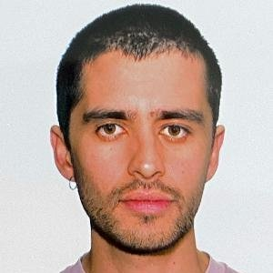
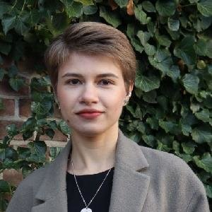
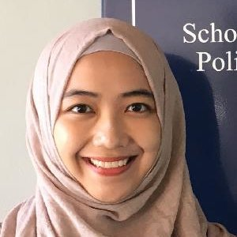
AI DEMOS LAB
Olya Kudina, PI
values and AI
Dmitry Muravyov, PhD cand.
Generative AI, trust, epistemology
Jordi Viader Guerrero, PhD cand.
Social medial and political subjectivation
Karin Bogdanova, PhD cand.
AI mental healthcare and diversity, inclusion
Meike Hardt,
PhD cand.
AI public infrastructures, care relations, contestations
Syafira Aulia,
PhD cand.
Adversarial ML for privacy-enhanced deliberation online
Nazli Cila, PI
more-than-human design

Slide 4
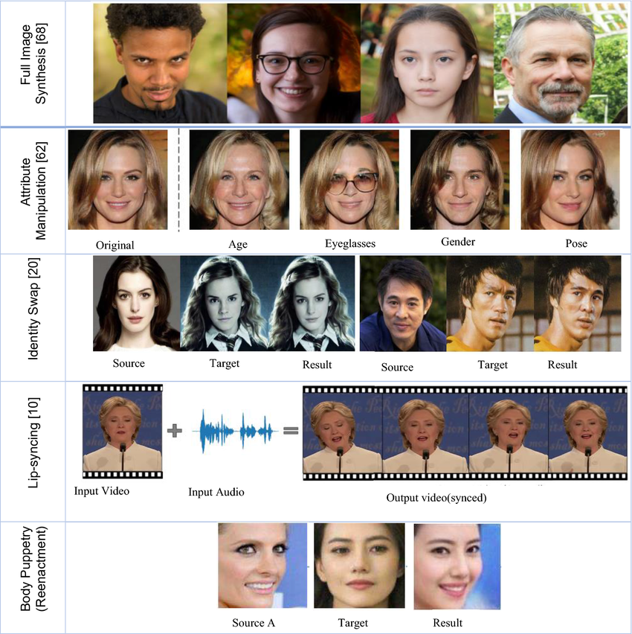
deepfakes
Synthetic media, generated entirely or modified partly with AI models
Images, videos, audio, text
Most often, “deepfake” = videos
First use, only in 2017
Image source: Dagar, D., & Vishwakarma, D. K. (2022). A literature review and perspectives in deepfakes: generation, detection, and applications. International journal of multimedia information retrieval, 11(3), 219-289.

Slide 5
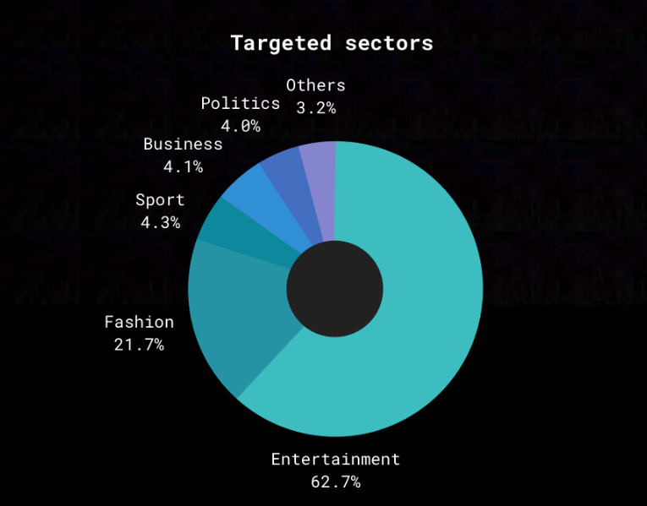
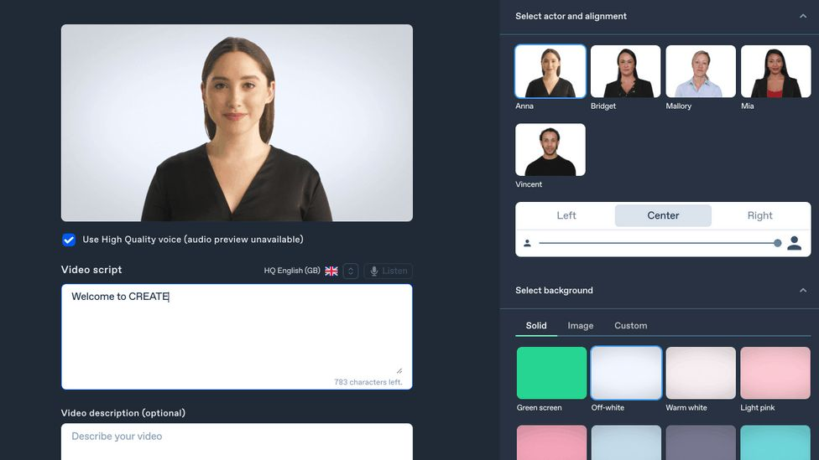
Proliferation of deepfakes
Image source: Giorgio Patrini et. al. (2020). The State of Deepfakes Landscape, Threats, and Impact. Deeptrace (now Sensity)

Slide 6
Entertainment leading

Slide 7
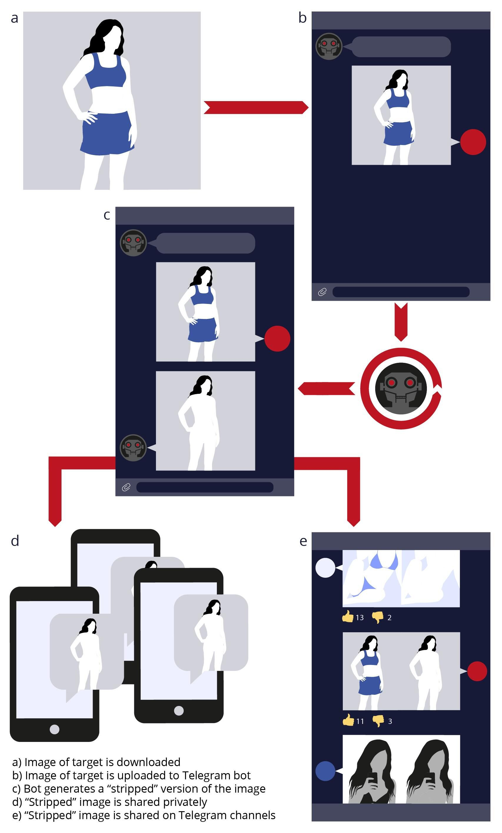
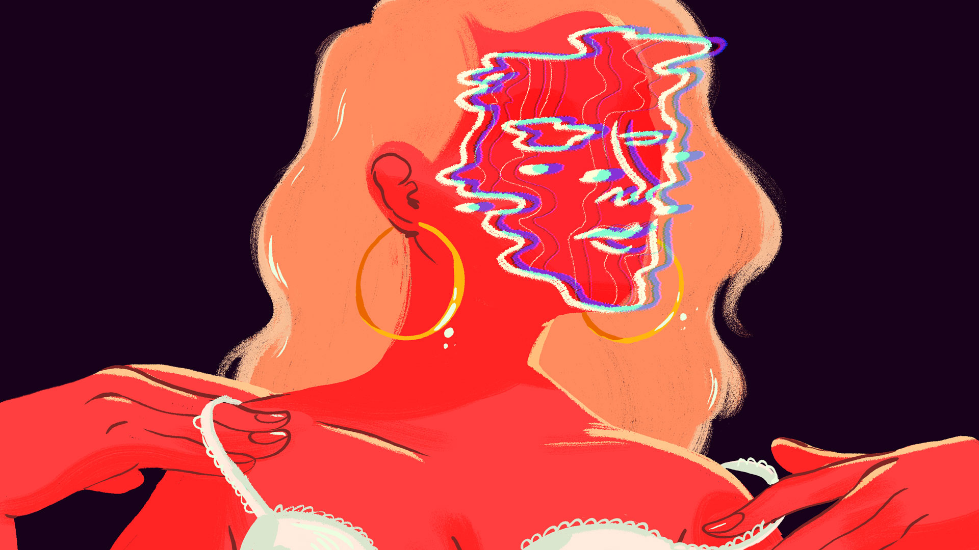
malicious use
To harass, intimidate, and undermine people, e.g. identity fraud, revenge porn, etc.
https://www.technologyreview.com/2021/02/12/1018222/deepfake-revenge-porn-coming-ban/
https://www.cnet.com/news/deepfake-bot-on-telegram-is-violating-women-by-forging-nudes-from-regular-pics/

Slide 8
Fake or real?

Slide 10
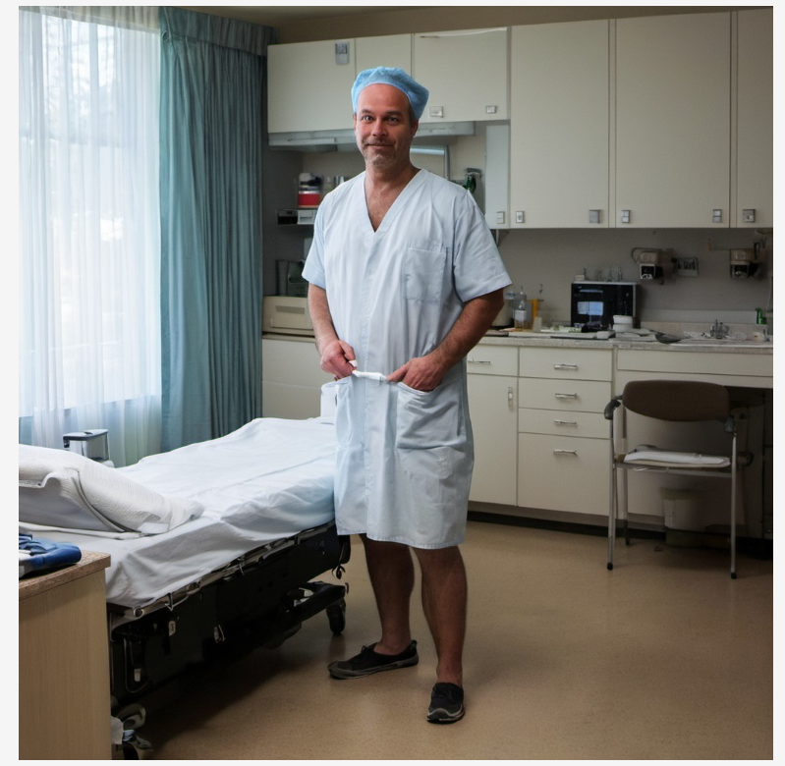

Slide 11
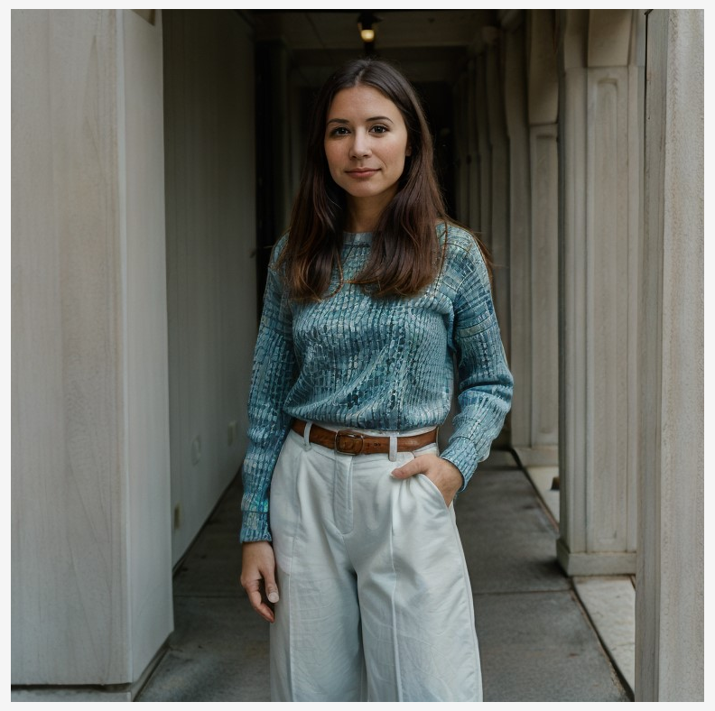

Slide 12
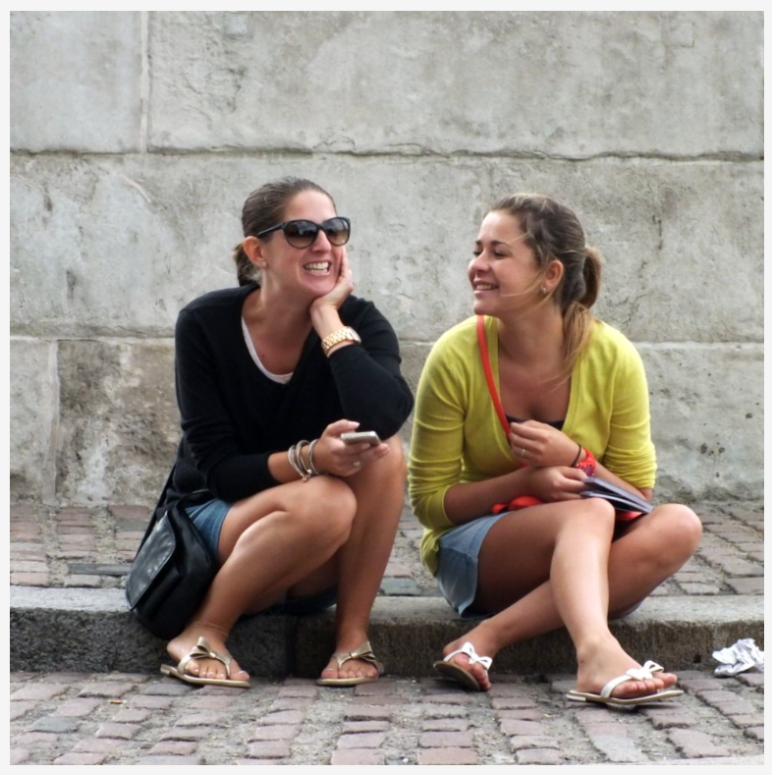

Slide 13
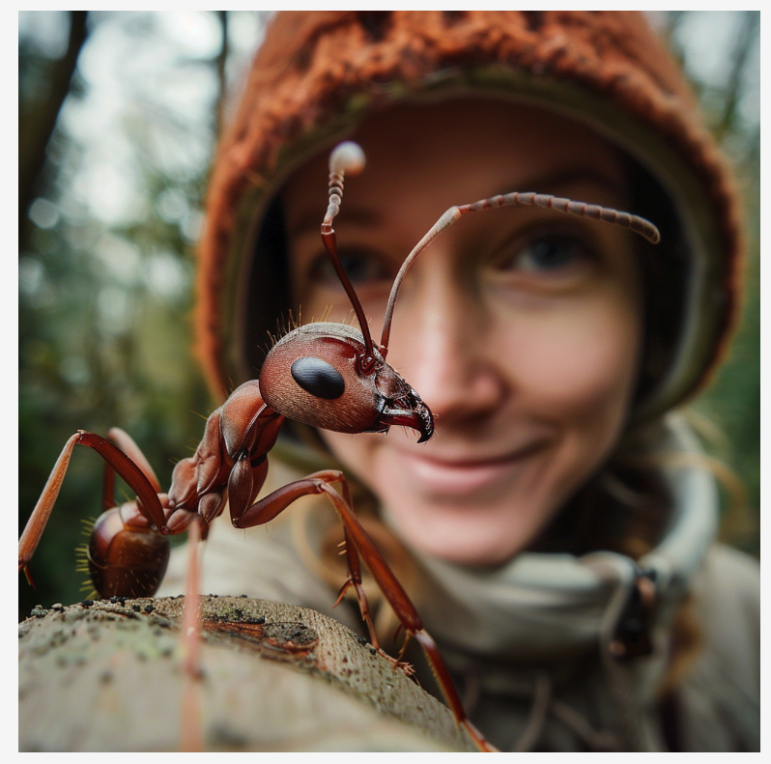

Slide 14
Seeing-is-believing
People correctly identify AI-generated videos & images in only 18% of cases (Kobis et al., 2021)
However, the more context – the better the result: videos with subtitles are better identifiable than video-only or text-only - 57-82% accurate (Groh et al., 2024)
People grossly overestimate their capacity to distinguish AI-generated content – because of overconfidence and the bias towards authenticity
Köbis, N. C., Doležalová, B., & Soraperra, I. (2021). Fooled twice: People cannot detect deepfakes but think they can. Iscience, 24(11).
Groh, M., Sankaranarayanan, A., Singh, N., Kim, D. Y., Lippman, A., & Picard, R. (2024). Human detection of political speech deepfakes across transcripts, audio, and video. Nature communications, 15(1), 7629.

Slide 15
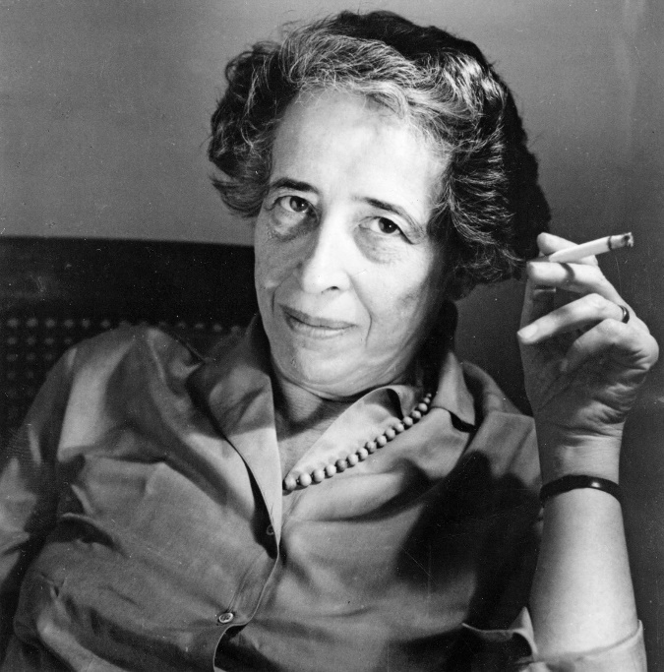
democracy?
Politics = plurality, diversity = active citizenship based on human interaction with each other, the value of civic engagement, and collective deliberation about matters affecting the community
= space for public interaction and engagement
“Political activity is valued not because it may lead to agreement …, but because it enables each citizen to exercise his or her powers of agency, to develop the capacities for judgment.”
Hannah Arendt (1906-1975)

Slide 16
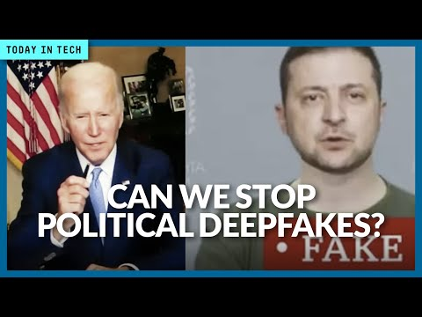
Deepfakes: Political threats
Misinformation
Confusion
Destabilization
Making people more susceptible to manipulation
Image source: https://www.youtube.com/watch?v=ALhhxJ4OrrE&ab_channel=TECHtalk

Slide 17
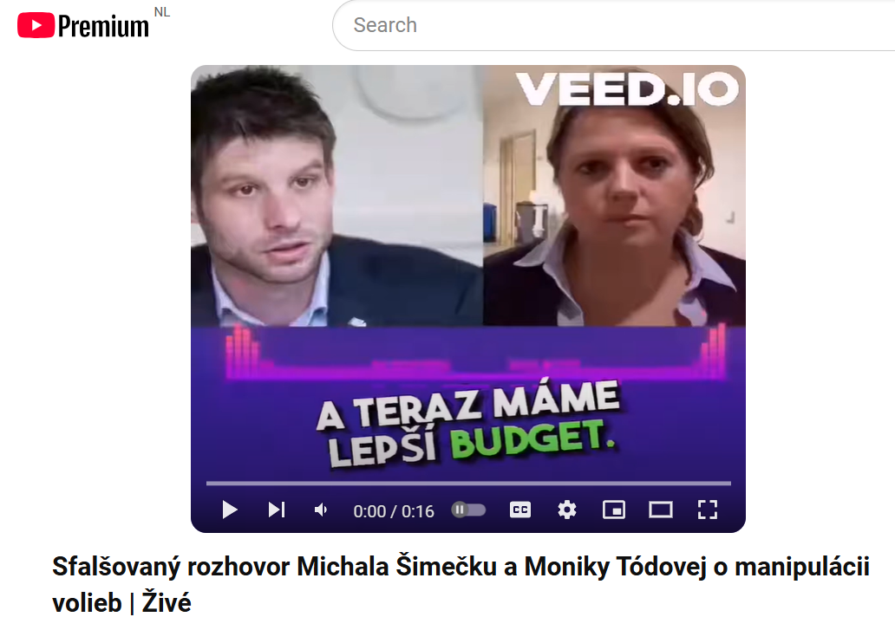
Slovakia elections (2023)
2023 Slovak parliamentary elections: pro-Russian Fico vs. pro-European Šimečka.
Two days before the election, a fake audio clip of Šimečka, “discussing” electoral fraud with a prominent journalist.
Although both quickly denied its authenticity, the clip went viral.
de Nadal, L., & Jančárik, P. (2024). Beyond the deepfake hype: AI, democracy, and “the Slovak case”. HKS Misinformation Review, 5(4).

Slide 18
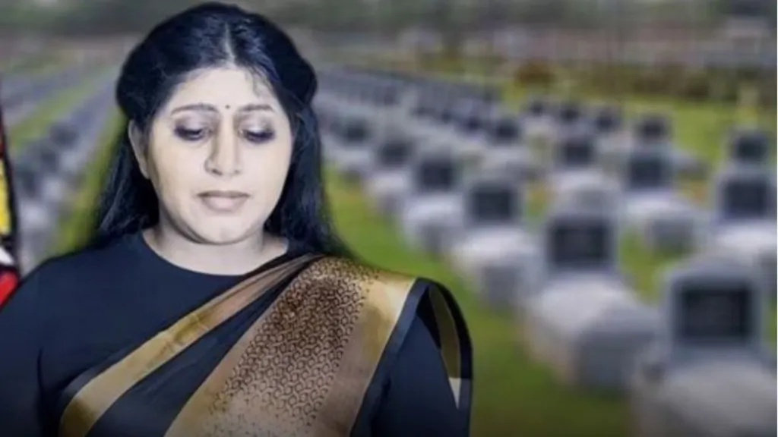
India elections (2024)
In a YouTube stream, a deepfake rendition of Duwaraka, daughter of ​​Tamil Tiger militant chief, was trying to influence voters in the southern Indian state Tamil Nadu.
Duwaraka died in 2009, when she was 23. Here, she appeared aged.
https://www.bbc.com/news/world-asia-india-68918330

Slide 19
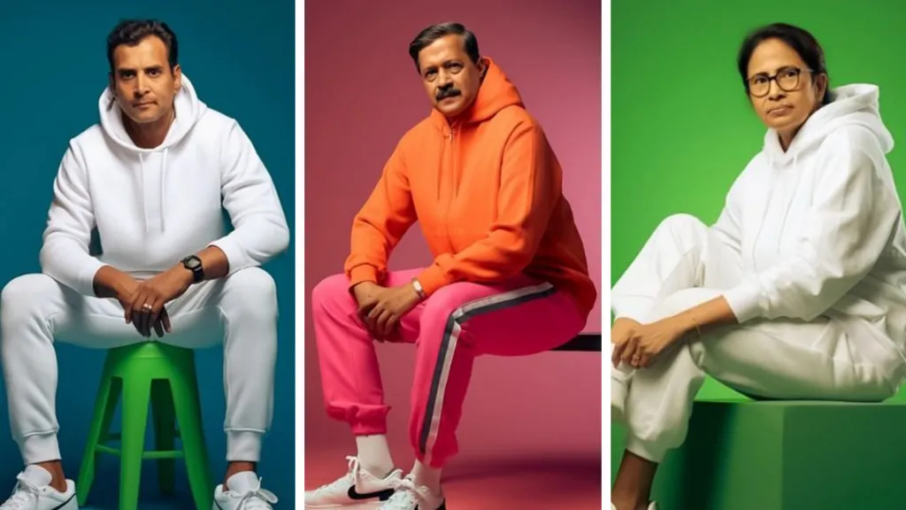
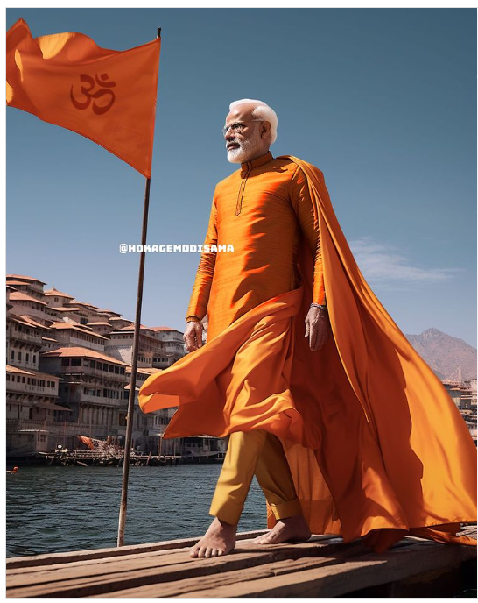
India elections (2024)
India - a deepfake “champion” in using AI in elections:
campaign videos
personalized audio messages in a range of Indian languages
automated calls made to voters in a candidate's voice
https://www.bbc.com/news/world-asia-india-68918330

Slide 20
USA elections (2024)
Deepfake Biden robocall urges Democrats to skip New Hampshire primary
Using his signature phrase, “What a bunch of malarkey”
https://www.youtube.com/watch?v=FCs_zFbkf0M&ab_channel=TheTelegraph

Slide 21
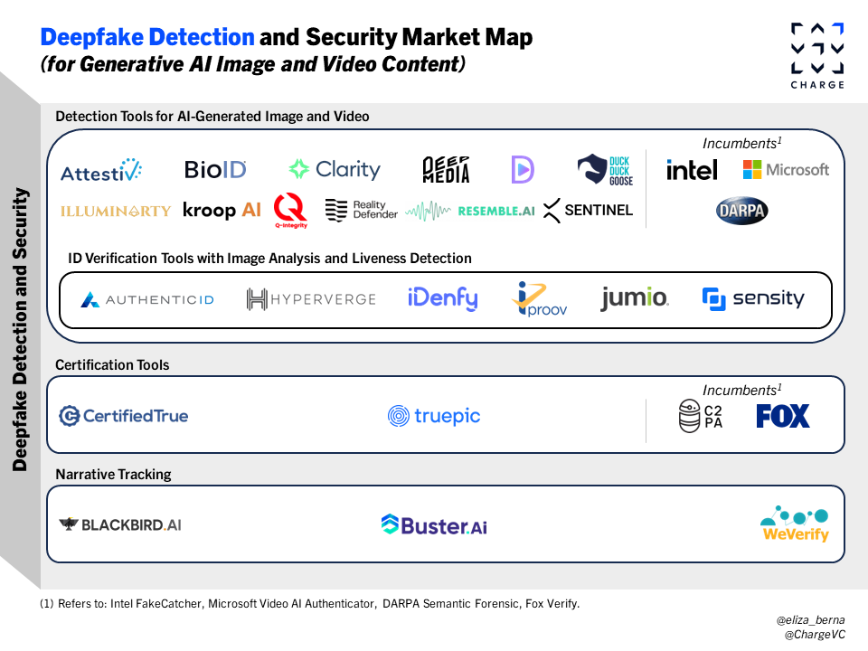
Dominant response
Detection tools
Fallible
Regulation: e.g. watermarks, disclosure, data provenance
Not applied equally across the globe (e.g. Midjourney forbade synthesizing images of US electoral candidates - but this was allowed in India and elsewhere)

Slide 22
Focus on knowledge
The solutions proposed suggest that the main problem with deepfakes is epistemological, a lack of knowledge to distinguish between authentic and AI-manipulated content.
Once we have the knowledge, we can make the right choice.
Is it really so?

Slide 23
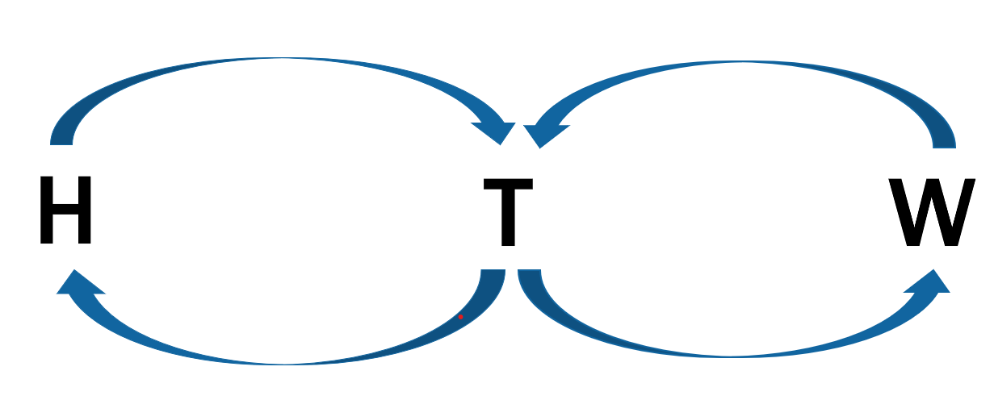
How we make sense of things

Slide 24
Technological mediation of relations
Deepfakes mediate our relation to the world, affecting
How we perceive ourselves and one another
How people go on to act on those perceptions
The values that underlie our decision-making (e.g. deliberation)
The problem with deepfakes is that they affect us, and our choices, even when we know that the content is AI-manipulated

Slide 25
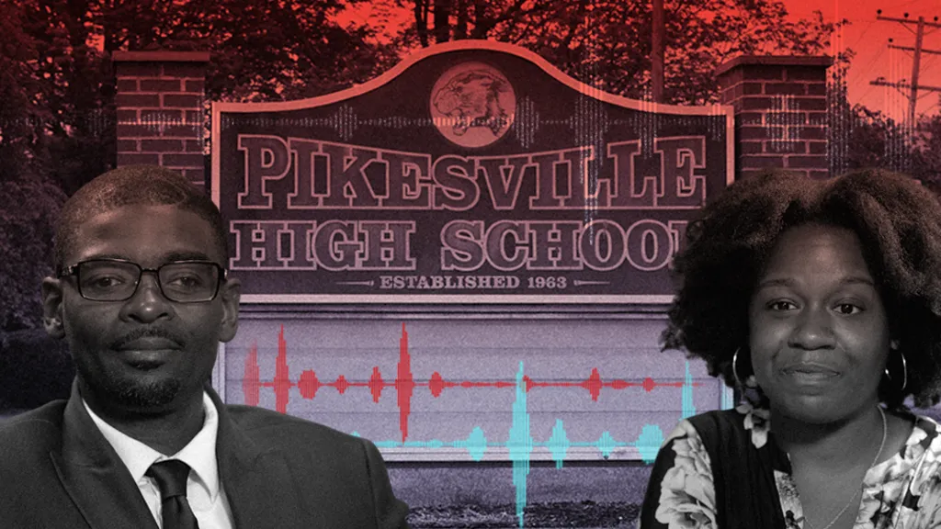
Beyond knowledge

Slide 26
Deepfakes <> democracy?

Slide 27
Beyond technological fix
People don’t trust just the digital artefact – rather, where and how it is positioned
Trust is relational - it has a profound social dimension, and cannot be reduced only to the technological
Who is the author? Do you know them? What do others say – online and offline? – we rarely make choices based on digital content alone

Slide 28
Trust but verify
Questioning potentially deepfake videos:
Does the video have a clearly stated author?
What is the URL and who is the host?
What seems to be the aims of this video?
Do you see the video elsewhere on the Internet, and if so, in what context?
Are there sources that corroborate what you are seeing and hearing?
https://deepfakes.virtuality.mit.edu/

Slide 29
Deepfakes can also bring democratic value

Slide 30
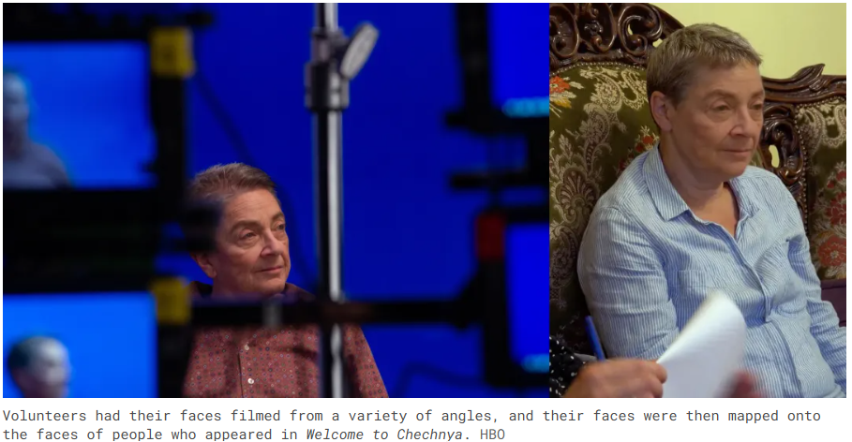
Deepfakes for plurality (Dmitry Muravyov)
Image source: https://www.vox.com/recode/2020/6/29/21303588/deepfakes-anonymous-artificial-intelligence-welcome-to-chechnya

Slide 31
Deepfakes for empowerment
https://www.youtube.com/watch?v=RV_SdCfZ-0s&ab_channel=O2

Slide 32
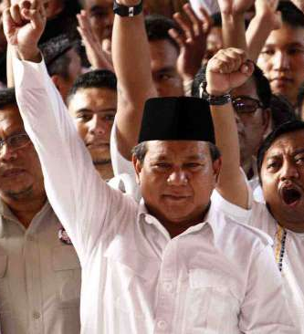
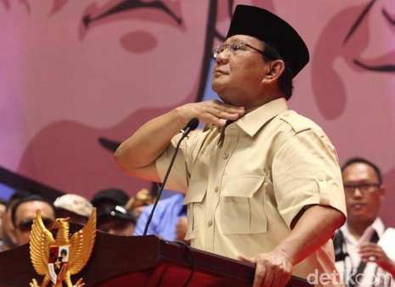
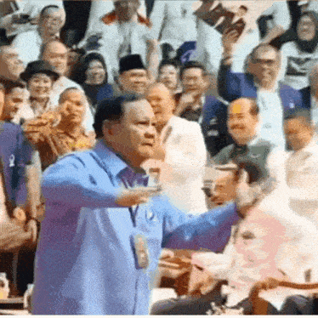
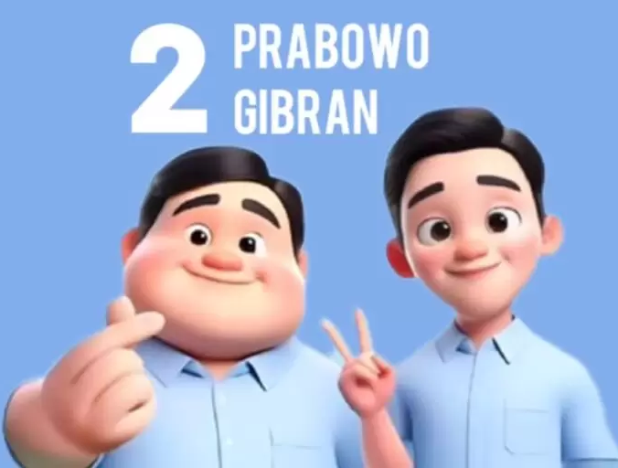
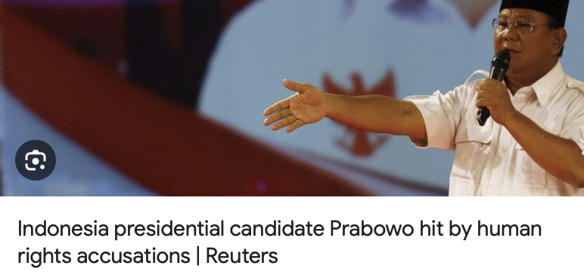
Beyond deepfakes: Elections in Indonesia & AI microtargeting (Syafira Auliya)
Prabowo before-2024
(lost 2x elections)
Prabowo in 2024
(won)

Slide 33
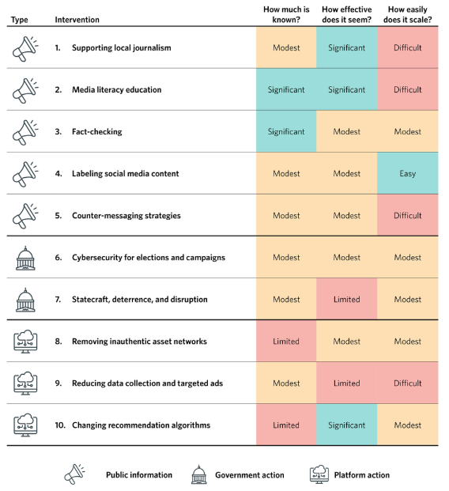
Misinformation: A long-term response needed
Bateman, J., & Jackson, D. (2024). Countering disinformation effectively: an evidence-based policy guide. Carnegie Endowment for International Peace.

Slide 34
Deepfakes <> democracy: a Complex response
It’s not wise to rely mostly on technological detection tools
Any AI is a complex sociotechnical system – any response to it equally requires social and technical responses
Public awareness + Policy + Trust-but-verify approach + Technology
It is about fostering a culture of critical engagement and collective responsibility in how we present ourselves and perceive others, how we consume information, and how we make decisions based on it.

Slide 35
Thank you for your attention! Questions?
Olya Kudina
@OlyaKudina
o.kudina@tudelft.nl
www.olyakudina.com
This work is supported by the TU Delft AI Lab programme, particularly through the AI DeMoS Lab

Slide 36
Test yourself: fake or not?
Detect Fakes project at Northwestern University Kellogg School of Management:
https://detectfakes.kellogg.northwestern.edu/

Slide 37
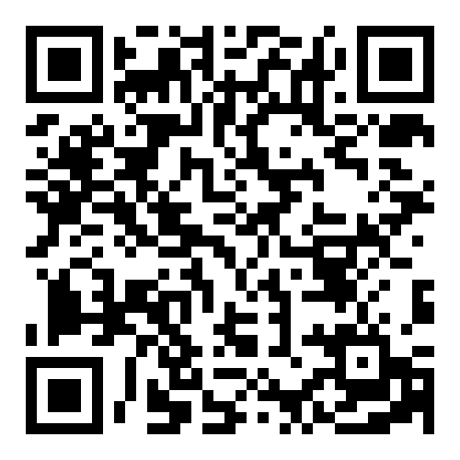
December 2023. Lexington Books Rowman & Littlefield. Open access free e-book!
https://rowman.com/WebDocs/Moral_Hereneutics.pdf

