Slide 1
De snelste weg naar de beste behandeling
Prof.dr. Marc Bonten
Julius Center for Health Sciences and Primary Care

Slide 2
A new disease spectrum: COVID-19
Asymptomatic / Mild upper respiratory tract infection (RTI) symptoms
Moderate-severe RTI symptoms (incl fever, severe cough, shortness of breath)
Severe RTI, hypoxemia, feeling of “drowning”
ARDS, respiratory insufficiency and pulmonary thrombosis/emboli
Ambulatory care
Hospital care

Slide 3


Platform trials – the beauty of the beast …
Derek Angus, CIO, UPMC
Lennie Derde, UMCU
Marc Bonten, UMCU

Slide 4
Snelheid van klinisch geneesmiddelen onderzoek tijdens een pandemie
Infected patients
time
Public Health response
Preclinical research response
clinical research response

Slide 5
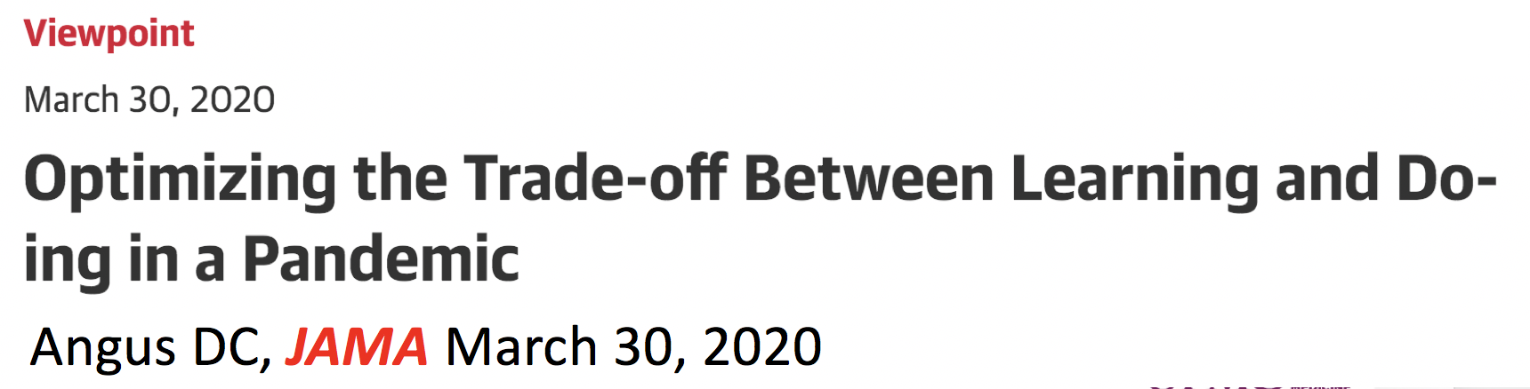
Learning While Doing
Must do two things simultaneously
  Do: Treat patients as well as possible
  Learn: Find out what therapies help

Slide 6

Learning While Doing
Must do two things simultaneously
  Do: Treat patients as well as possible
  Learn: Find out what therapies help
Framed as a (potentially false) choice

Slide 7
Learning While Doing
Must do two things simultaneously
  Do: Treat patients as well as possible
  Learn: Find out what therapies help
Framed as a (potentially false) choice
Classic dilemma in decision-making under uncertainty
  The ‘exploration/exploitation trade-off’
    James March, Org Sci 1991
The (elusive) solution is an integrated approach
  Find the optimal balance to treat patients as well as possible and learn as fast as possible

Slide 8
Outside medicine …
Exploration/exploitation (or ‘Learning While Doing’) is everywhere …
  Cornerstone of decision-making under uncertainty
Complex Adaptive Systems research in multiple disciplines
    Organization science, mathematics, evolutionary biology, economics, social sciences
Artificial intelligence
  Reinforcement learning
  Multi-arm bandits, Markov decision processes, policy evaluations, etc.
All disciplines exploring the optimal trade-off …

Slide 9


Inside medicine …
‘Doing’ (practice) and ‘Learning’ (research) are separate
  Separate organizations, cultures, people, funding, procedures, and goals
Consequence: no one really empowered to find the optimal trade-off
  Always true, but particularly obvious during a pandemic
Research
Clinical practice

Slide 10
Best learning tool is the Randomized Controlled Trial, but 3 major challenges in a pandemic …
Randomization is very uncomfortable
  Physician feels responsible for patient outcomes, consequences are immediate
  Physician feels less responsible for research, consequences are remote
RCTs are very cumbersome
  Slow to start
  Intrusive to execute
Little coordination in the clinical research enterprise
  >100 RCTs registered for HCQ; few likely to be completed
  Clinicians bombarded with 100s of requests to participate in trials; no national or global prioritization

Slide 11
3 solutions from the clinical research enterprise, designed to ‘lean in’ to the realities of clinical care …
Make randomization more comfortable
  Multiple arms, only one is control
  Adaptive randomization, preferentially assign to best therapy over time
Make entry into clinical trials ‘1-stop shopping’
  Simplify interface between clinical practice and clinical research
  Use master protocols with standard entry criteria, outcomes, etc.
  Essentially, combine trials/study questions
Sacrifice ‘sacred cows’ of research
  Don’t let perfection be the enemy of the good
  Ex. placebo probably overrated in a pandemic; added rigor not worth the burden

Slide 12

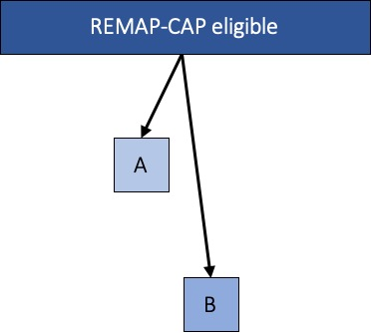


Study eligible
Adaptive Platform Trials
Randomized Controlled Trials
Notes:
And with that design, instead of this

Slide 13
REMAP-CAP Executive Summary
A global adaptive platform trial
Designed to determine best treatment for severe pneumonia
  Randomizes multiple interventions simultaneously, nested within domains
  Uses a multifactorial Bayesian inference model
  Uses response-adaptive randomization
Assesses both interpandemic AND pandemic forms of pneumonia
  Pre-set rules to switch into pandemic mode
Entered pandemic mode in February 2020

Slide 14
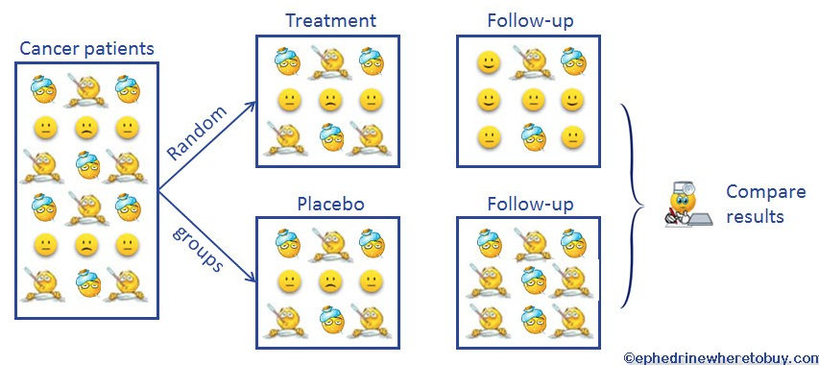

The traditional RCT ...
Patients with disease X
Treatment – ‘A’
At the start,
50% chance
that A > B
Placebo – ‘B’

Slide 15
The traditional RCT ...
Patients with disease X
At the end, >99% sure that A > B
What about in the middle?

Slide 16
A planned trial of A vs. B in 400 patients
After 40 enrolled …
40
Dead
# of
patients
20
Alive
A
B
The probability that A > B = 78%
Start randomizing MORE patients to A than B …

Slide 17
After 80 patients …
40
Dead
# of
patients
20
Alive
A
B
Now, the probability that A > B = 99.9%
Stop the trial!

Slide 18
Caveats
If the ‘second’ 40 was flat or opposite direction …
  Trial continues and the next ‘bet’ swings back closer to 50:50
When 2 groups, power driven by the smaller group
So, NOT very helpful if …
  Single homogenous cohort
  Two arms
But, becomes VERY interesting when …
  Multiple arms
  Multiple subgroups

Slide 19





Response-adaptive randomization
A
B
C
Randomization rule
Statistical model

Slide 20
Response-adaptive randomization
Odds weighted towards best RX
A
B
C
Randomization rule
Statistical model

Slide 21
Response-adaptive randomization
New arms activated
A
B
C
D
Randomization rule
Statistical model

Slide 22
Response-adaptive randomization
Or dropped
A
B
D
Randomization rule
Statistical model

Slide 23

Response-adaptive randomization
Different weights for different patient groups
A
B
C
Randomization rule
Statistical model

Slide 24
RANDOMIZED
Allow CAUSAL inference
EMBEDDED
Align with care; leverage the EHR
= R E M A P
MULTIFACTORIAL
Multiple treatments and subgroups
ADAPTIVE
Match odds of success to odds of assignment
PLATFORM
Perpetual enrollment; continuous learning

Slide 25
REMAP elements
Domain – an area where a question is asked …
  Domain #1 – choice of antibiotic
  Domain #2 – whether to give steroids or not
  Domain #4 – choice of ventilator strategy
  Etc. ….
Intervention
  Any option within a domain …
Regimen
  Unique combination of interventions within a domain …
Stratum
  Baseline subgroup
  Ex. Moderate vs. Severe COVID19 at presentation

Slide 26
Multifactorial intervention assignments
Regimen = set of domain-specific interventions
Effect of an intervention is conditional upon
Stratum
Interventions within other domains
Regimen | Domain A | Domain B | Domain C
#1 | A1 | B1 | C1
#2 | A1 | B1 | C2
#3 | A1 | B2 | C1
#4 | A1 | B2 | C2
#5 | A2 | B1 | C1
…..
#n | An | Bn | Cn

Slide 27

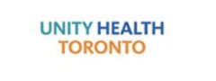



Slide 28
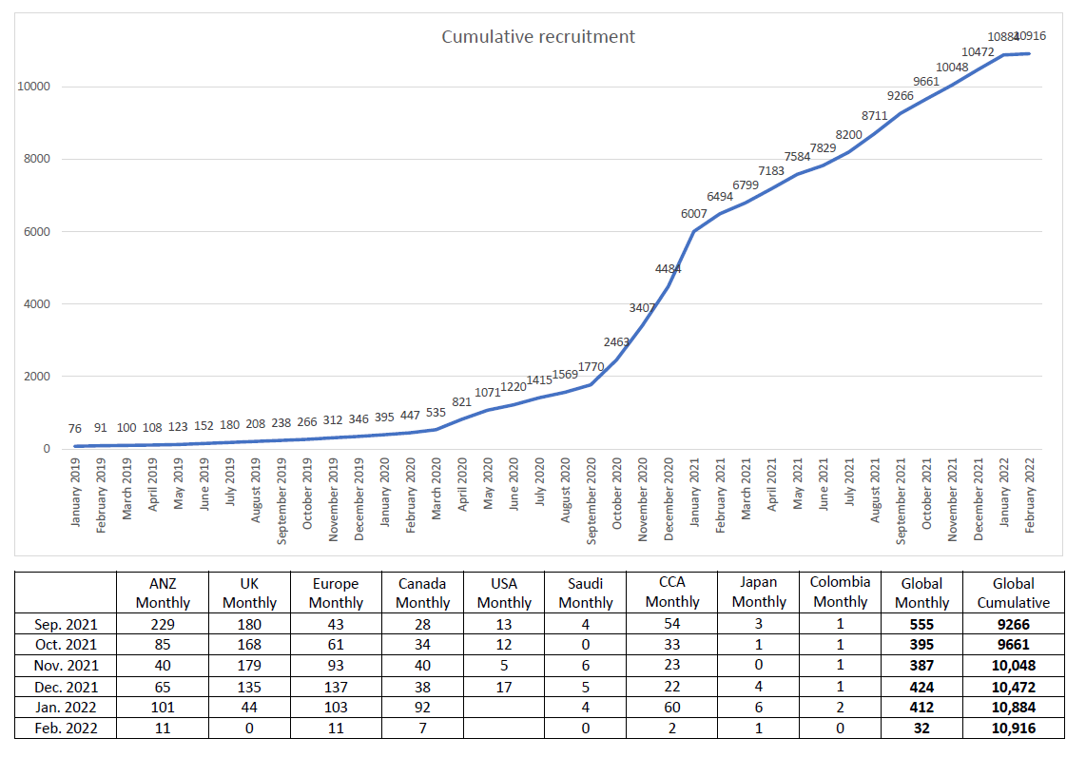
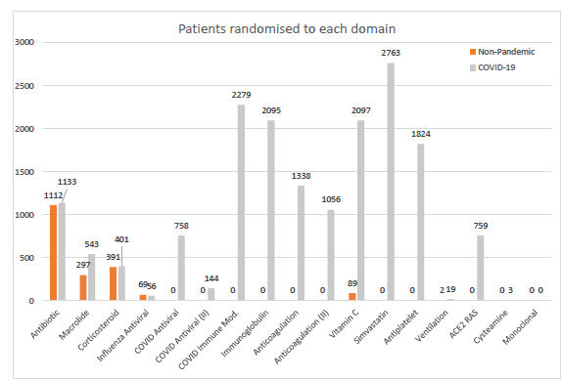

Slide 29

Corticosteroids
REMAP-CAP Investigators JAMA 2020;324(13):1317-1329
REACT Working Group JAMA 2020;324(13):1330-1341
WHO living guideline BMJ 2020;370:m3379 (first version)

Slide 30

Hydroxychloroquine
Lopinavir/ritonavir
REMAP-CAP Investigators, Intensive Care Med 2021 Aug;47(8):867-886
Cathrine Axfors et al., Nature Comms. 2021; 12: 2349

Slide 31
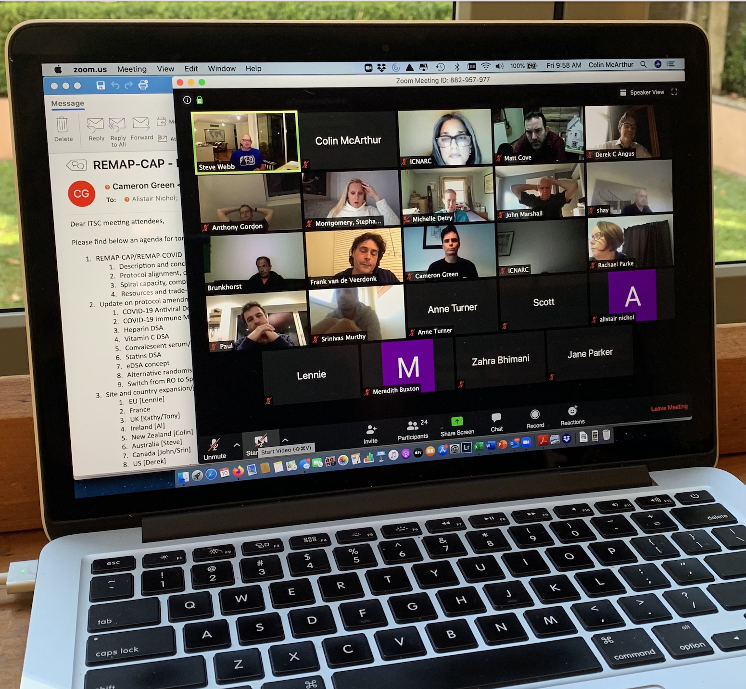
Tocilizumab
Sarilumab
The REMAP-CAP investigators NEJM 2021; 384(16):1491-1502
WHO REACT Working Group JAMA 2021;326(6):499-518

Slide 32
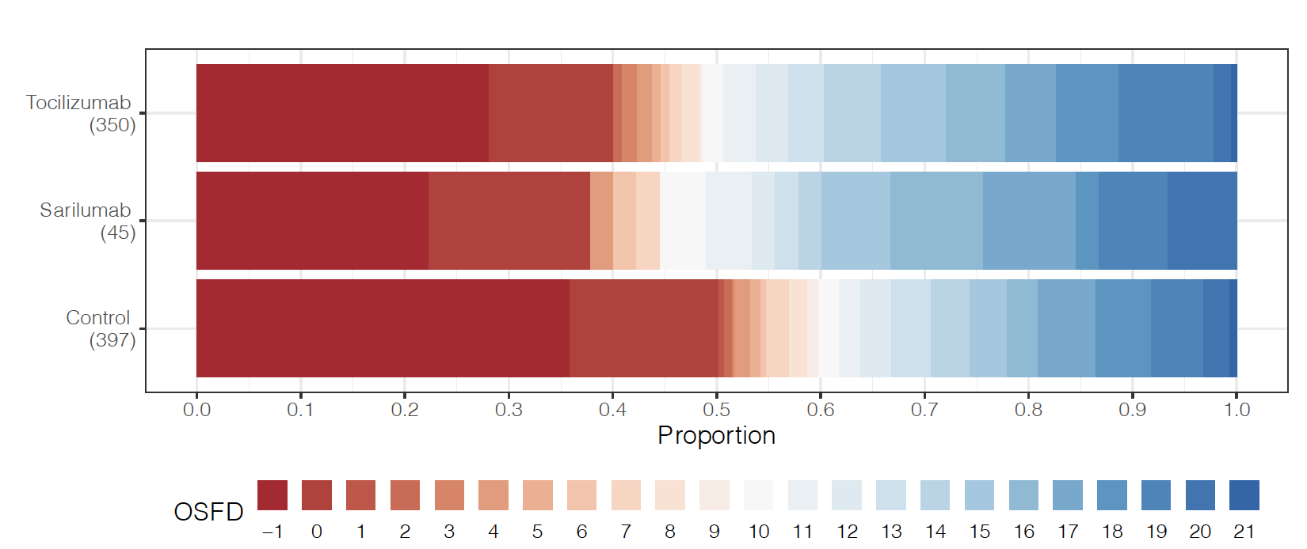
Notes:
Here you can see a visual representation of the primary outcome

Slide 33
Primary and Secondary Outcomes
 | Tocilizumab (N=353) | Sarilumab (N=48) | Control (N=402)
Organ support-free days (OSFDs)
Median (IQR) | 10 (-1 to 16) | 11 (0 to 16) | 0 (-1 to 15)
Median adjusted OR (95% CrI) | 1.64 (1.25 to 2.14) | 1.76 (1.17 to 2.91) | 1
Probability of superiority to control, % | >99.9 | 99.5 | -
Subcomponents of OSFDs
In-hospital deaths, n (%) * | 98/350 (28.0) | 10/45 (22.2) | 142/397 (35.8)
OSFDs in survivors, median (IQR) | 14 (7 to 17) | 15 (6.5 to 17) | 13 (4 to 17)
Primary Hospital Survival
Median adjusted OR (95% CrI) | 1.64 (1.14 to 2.35) | 2.01 (1.18 to 4.71) | 1
Probability of superiority to control, % | 99.6 | 99.5 | -
* = Hospital mortality pooling both IL-6ra was 27.3%
Notes:
This shows you the primary and secondary outcomes
Median organ support-free days were 10 , 11 and 0 for tocilizumab, sarilumab and control groups, respectively
Compared with control, median adjusted odds ratios (from the primary model) were 1.64 for tocilizumab and 1.76 for sarilumab, yielding >99.9% and 99.5% posterior probabilities of superiority.
Hospital mortality was 28.0% (98/350) for tocilizumab, 22.2% (10/45) for sarilumab and 35.8% (142/397) for control.
The hospital mortality pooling both IL-6 receptor antagonists was 27.3% (108/395).
Compared with control, median adjusted odds ratios for hospital survival were 1.64 for tocilizumab and 2.01 for sarilumab, yielding 99.6% and 99.5% posterior probabilities of superiority.
The sensitivity analyses were consistent with the primary analysis
Of note, the estimates of the treatment effect for patients treated either with tocilizumab or sarilumab and corticosteroids in combination were greater than for any intervention on its own, suggesting benefit of using both IL6 receptor antagonists and corticosteroids together in this critically ill population.

Slide 34
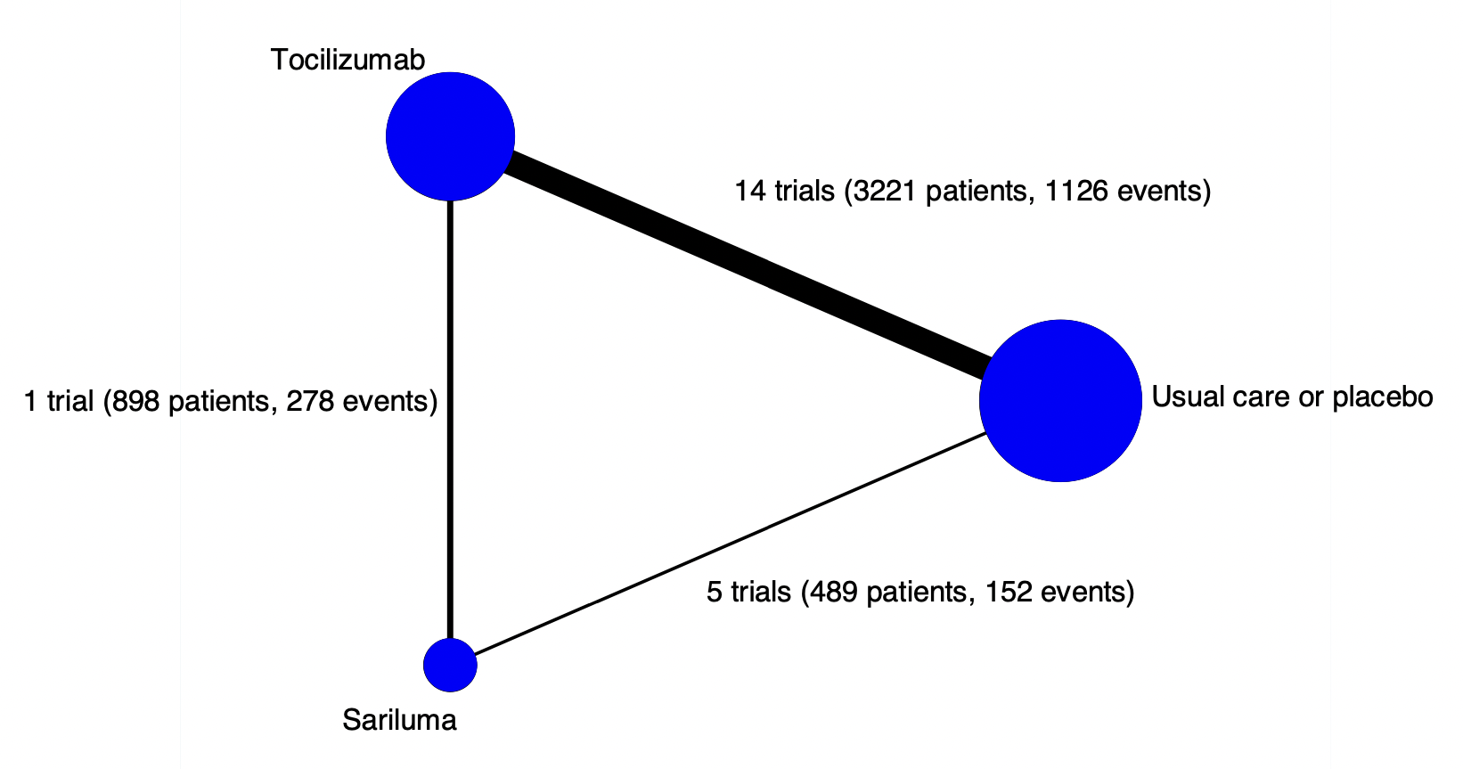
WHO REACT group www.medrxiv.org/content/10.1101/2021.08.26.21262523v1
Notes:
The node size is proportional to the number of trials that include this treatment
The width of the lines is proportional to the total number of events involved in each direct comparison
ORs for 28-day mortality similar for tocilizumab and sarilumab compared with usual care or placebo is similar.

Slide 35

TAC
in non-critically ill patients
no TAC
in critically ill patients
The REMAP-CAP, ACTIV-4a, and ATTACC Investigators NEJM 2021; 385:777-789
The ATTACC, ACTIV-4a, and REMAP-CAP Investigators NEJM 2021; 385:790-802

Slide 36

Convalescent plasma
Antiplatelet therapy
Writing Committee for the REMAP-CAP Investigators JAMA 2021;326(17):1690-1702
Notes:
Among critically ill adults with confirmed COVID-19, treatment with 2 units of high-titer, ABO-compatible convalescent plasma had a low likelihood of providing improvement in the number of organ support–free days.
The median-adjusted OR was 0.97 (95%credible interval, 0.83 to 1.15) and the posterior probability of futility (OR <1.2)was 99.4%for the convalescent plasma group compared with the no convalescent plasma group. The treatment effects were consistent across the primary outcome and the 11 secondary outcomes. Serious adverse events were reported in 3.0%(32/1075) of participants in the convalescent plasma group and in 1.3% (12/905) of participants in the no convalescent plasma group.

Slide 37
corticosteroids
tocilizumab
sarilumab
TAC in ward
HCQ
lopinavir/r
anakinra
CP
TAC in ICU
antiplatelet therapy
The REMAP-CAP investigators NEJM 2021; 384(16):1491-1502
WHO REACT Working Group JAMA 2021;326(6):499-518
Notes:
summary of platform conclusions

Slide 38
Conclusion | Result | Publications
Corticosteroids | Benefit | REMAP-CAP Investigators, JAMA 2020;324(13):1317-1329 REACT Working Group, JAMA 2020;324(13):1330-1341 WHO living guideline, BMJ 2020;370:m3379 (first version)
Lopinavir/ritonavir Hydroxychloroquine | Likely harm Harm | REMAP-CAP Investigators, ICM 2021 Aug;47(8):867-886 Cathrine Axfors et al., Nature Comms 2021; 12: 2349
Tocilizumab Sarilumab Anakinra Interferon beta-1a | Benefit Benefit Futile Operationally futile | The REMAP-CAP investigators NEJM 2021; 384(16):1491-1502 WHO REACT Working Group JAMA 2021;326(6):499-518 The REMAP-CAP Investigators www.medrxiv.org/content/10.1101/2021.06.18.21259133v2 WHO REACT group www.medrxiv.org/content/10.1101/2021.08.26.21262523v1
Heparin – moderate | Benefit | The ATTACC, ACTIV-4a, and REMAP-CAP Investigators NEJM 2021; 385:790-802
Heparin – severe | Futile | The REMAP-CAP, ACTIV-4a, and ATTACC Investigators NEJM 2021; 385:777-789
Convalescent plasma | Futile | Writing Committee for the REMAP-CAP Investigators JAMA 2021;326(17):1690-1702
Aspirin | Futile | Under review
Notes:
REMAP-CAP Investigators, JAMA 2020;324(13):1317-1329 (steroids)
REMAP-CAP Investigators, Intensive Care Med 2021 Aug;47(8):867-886 (antiviral HCQ and lopinavir/r)
The REMAP-CAP investigators NEJM 2021; 384(16):1491-1502 (IL-6ra)
The REMAP-CAP Investigators www.medrxiv.org/content/10.1101/2021.06.18.21259133v2 (full IM1 including anakinra)
The ATTACC, ACTIV-4a, and REMAP-CAP Investigators NEJM 2021; 385:790-802 (heparin in Severe State)
The REMAP-CAP, ACTIV-4a, and ATTACC Investigators NEJM 2021; 385:777-789 (heparin in Moderate State)
The REMAP-CAP Investigators https://www.medrxiv.org/content/10.1101/2021.06.11.21258760v1 (CP)

Slide 39





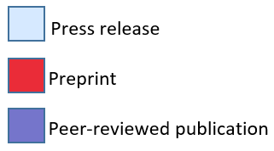

 |  | March | April | May | June | July | August | Sept | Oct | Nov | Dec | Jan | Feb | March | April | May | June | July
Steroids | RECOVERY |  |  |  | 16 Jun | 17 Jul |  |  |  |  |  |  | 25 Feb
 | REMAP-CAP |  |  |  |  |  |  | 2 Sep
Il-6 receptor antagonists | RECOVERY |  |  |  |  |  |  |  |  |  |  |  | 11 Feb
 | REMAP-CAP |  |  |  |  |  |  |  |  | 19 Nov |  | 7 Jan | 25 Feb
Anakinra | REMAP-CAP |  |  |  |  |  |  |  |  |  |  |  |  |  | 10 Apr |  | 18 Jun
Hydroxychloroquine | RECOVERY |  |  |  | 5 Jun | 15 Jul |  |  |  | 19 Nov
 | REMAP-CAP |  |  |  |  |  |  |  | 22 Oct |  |  |  |  |  | 15 Apr
Lopinavir/Ritonavir | RECOVERY |  |  |  | 29 Jun |  |  |  | 24 Oct
 | REMAP-CAP |  |  |  |  |  |  |  |  | 19 Nov |  |  |  |  |  |  |  | 09 Jul
Azithromycin | RECOVERY |  |  |  |  |  |  |  |  |  | 14 Dec |  | 13 Feb
Colchicine | RECOVERY |  |  |  |  |  |  |  |  |  |  |  |  | 5 Mar
Convalescent Plasma | RECOVERY |  |  |  |  |  |  |  |  |  |  | 15 Jan |  | 10 Mar
 | REMAP-CAP |  |  |  |  |  |  |  |  |  |  | 7 Jan |  |  |  |  | 10 Jun
Anticoagulation for severe COVID-19 | REMAP-CAP |  |  |  |  |  |  |  |  |  | 19 Dec |  |  | 12 Mar
Anticoagulation for moderate COVID-19 | REMAP-CAP |  |  |  |  |  |  |  |  |  |  | 22 Jan |  |  |  | 17 May
Platelets | REMAP-CAP |  |  |  |  |  |  |  |  |  |  |  |  |  |  |  | 22 Jun
Sir Peter Horby
RECOVERY
Lennie Derde
REMAP-CAP

Slide 40
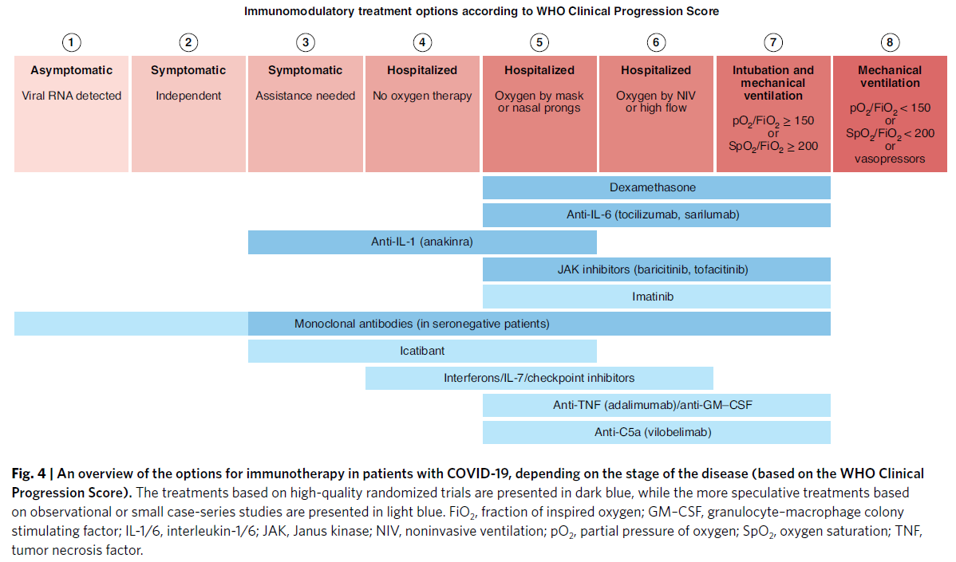


Slide 41
antibiotics and nested macrolides
corticosteroids in non-COVID CAP
antivirals for influenza*
antivirals for COVID-19
tromboprophylaxis strategies in ICU
RAS system modulation*
focussed IM
simvastatin
CP/mAb in immune compromised
vitamin C
endothelial modulation
ventilation
rescue corticosteroids
cysteamine
antiplatelet therapy in ICU

Slide 42









These projects have received funding from the European Union’s Horizon 2020 research and innovation programme under grant agreement No 101003589 and No 965313
Notes:
Together with HG, PH and MB, I have lived through those challenges for the last 2 years.
and we’ve recently written a Viewpoint about this, to which I will often refer in this talk.

Slide 43
Lancet Infect Dis 2021 Dec 21;S1473-3099(21)00705-2
Notes:
what I will do is take you through the steps of intervention research, and the thoughts we had on the challenges and on how we can improve.

Slide 44
Idea
screening system – JAAM, UK-CTAP, “pandemic research authority”
repurposed medication first – connection with EMA
new ways of collaboration – prospective MA, mpRCT
hard choices – UPH status in UK
Lancet Infect Dis 2021 Dec 21;S1473-3099(21)00705-2
Notes:
First, there needs to be a good research idea.
The challenge in this pandemic was not having an idea, but prioritization.
In the manuscript I just referenced, the FDA calls this a screening system.
The UK-CTAP has given input on interventions for both RECOVERY and REMAP-CAP, they are also both part of the JAAM set up under guidance of the EC, and are also guided by WHO priorities as well as internal priorization mechanisms.
Secondly, What we know is that the first available drugs to investigate in new, pandemic, diseases, are repurposed drugs, so connection to EMA and other stakeholders is crucial.
Also, we can be innovative by collaborating within, and outside the EU, with other groups to set up PMAs or mpRCTs, as we’ve successfully done with WHO but also with academic groups in the US in this pandemic.
There may have to be hard choices, but it can pay off. RECOVERY and REMAP-CAP both received UPH status in the UK.

Slide 45
Idea
Funding
H2020 competitive calls –grant writing takes time
aim to rapidly leverage pandemic funding – HERA incubator
connect national funding with EU funding (and globally)
fund networks that have delivered before
project-based funding not ideal to maintain trial infrastructure
Notes:
The second stage of the RCT process is obtaining funding.
In this pandemic, there was quick access to H2020 competitive calls, but it still required weeks of work to try and obtain these.
We had to invest and scale up, hire personnel, in the absence of secured funds.
We should aim to develop a mechanism to rapidly leverage pandemic funding and to connect EU funding with national funding
Funds provided by the EU Members States should incentivise academic and non-academic hospitals to participate in EU-funded clinical trials.
The European Commission has recognised this and has now developed HERA and the HERA incubator for this.
This is not an easy hurdle to tackle, but it is a major one, and we should really improve here before the next pandemic.
Practically, funding networks that have delivered before makes sense.
As a last remark, I wanted to flag that the current funding mechanisms are not ideal to maintain trial infrastructure between pandemics, which would be interesting to hear the views of the funders present here on.

Slide 46
Idea
Funding
Set up
design – (adaptive) platform trials, embedded
learning while doing
“kill your darlings” – placebo
seamless phase II-III ideal
viruses do not respect borders – international approach
The APT Coalition, NRDD 2019;18:797–807
Angus, DC JAMA 2020;323(19):1895-1896
Notes:
Many of the succesfull trials in this pandemic have been platform trials.
And trial success is also dependent on embedding the trial in clinical work, lowering the workload.
We have to word towards a form of “learning while doing” where we integrate learning (trials) into our daily clinical practice, as descrbed by DA in JAMA
We need to keep an open mind towards sometimes sacrificing sacred cows, like placebo, if appropriate, to make trials feasible. Perfect is the enemy of the good.
It is great if the trial design can faciliate things like seamless phase II/II designs.
And in the set-up, we need an international approach.

Slide 47
Idea
Funding
Set up
Delivery
delivery is key – we need operational infrastructure
simple & digital – adapting regulations?
pragmatic approach
variation in granularity within the platform?
contracts, ethics processes, national regulations, administration
Notes:
Delivery of the trials is key. There is no trial without excellent delivery, for which we need operational infrastructure.
And linking back to funding, this needs “maintenance”. You cannot build a new stadium for every pandemic game that you play.
We need to keep trials as simple as we can, and as digital as we can, working within the rules but also re-evaluating these rules maybe.
Thinking about platform trials we need to consider if and how we can have different granularity of data for different domains in the platform – for example for comparative effectiveness versus investigating IMPs.
One of the biggest hurdles in delivery of trials during the pandemic from our perspective is the length of procedures for contracts and ethisc
and the overwhelming amount of sometimes conficting regulations across the globe

Slide 48
Idea
Funding
Set up
Delivery
Conclusion
early disclosure of results – preprints
open access journals
collaboration for quick uptake in guidelines
Notes:
We did fairly well I think on making results available asap, especially with the use of preprints.
Journals have made all things COVID open access, which has been great.
And we’ve seen great collaboration with for instance WHO, but also national institutes, in incorporating the evidence into guidelines fast.

Slide 49
Then | Now | Future
Very few trials | Many small trials, some big | Collaboration, platform trials
Slow ethics approval | Reduced timelines +/- | Streamlined processes
Fragmented funding | Competitive grants | Pandemic funding, connected, continuous
Traditional, local | International collaboration | Continued collaboration, inclusive, LMIC, prioritization strategy
PEARL hurdles | Disconnect national – regional – global | Pandemic exemptions, facilitating collaboration, globally connected
No data in pandemic | Good data, > 10 conclusions
Notes:
In summary, there has been a lot of improvement since the 2009 pandemic, but this is the time to take steps to further prepare ourselves for the next pandemic.

Slide 50

www.remapcap.org and www.remapcap.eu
video’s available on vimeo
podcasts hosted by CCR via spotify/apple iTunes
WE4YOU meetings, livestream results, …
@remap_cap
@REMAPCAP
REMAP-CAP
Notes:
we disseminate results

