Slide 1



COVID-19: Lessen voor de toekomst
Prof Dr Marion Koopmans
WHO collaborating centre for Arbovirus and Hemorrhagic Fever Reference and Research
www.pdpcenter.nl
m.koopmans@erasmusmc.nl

Slide 2
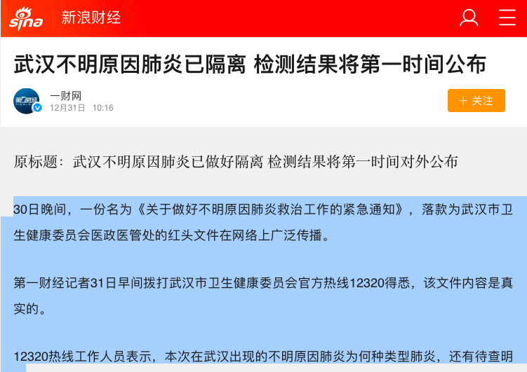
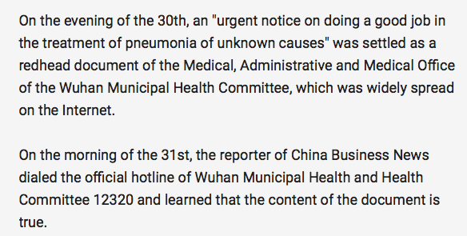
https://finance.sina.cn

Slide 3
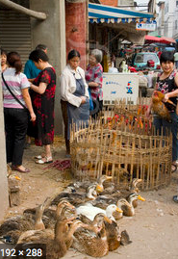
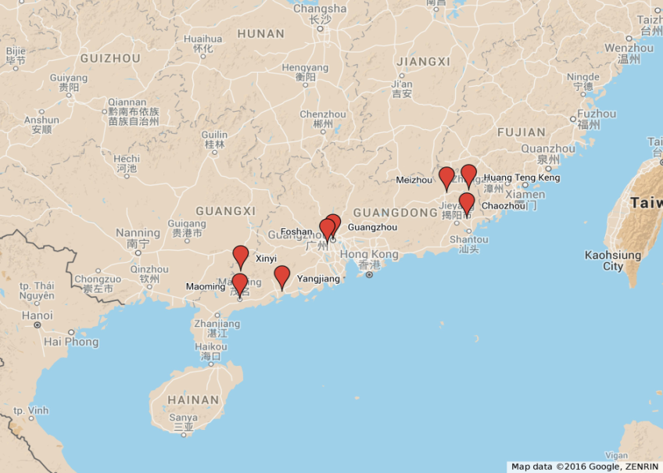
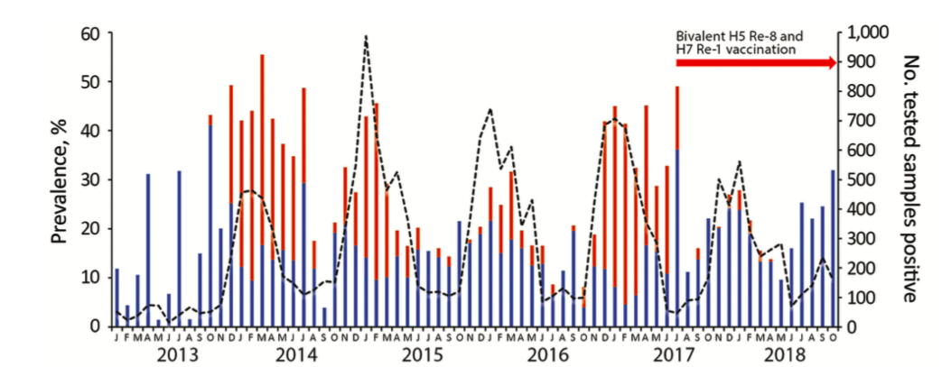
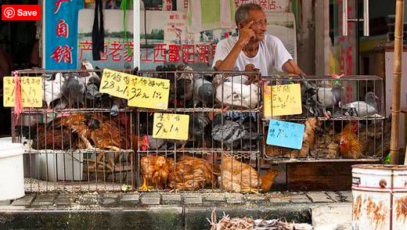

China en levende dieren markten
Bai et al., 2019; Sikkema et al, in preparation

Slide 4
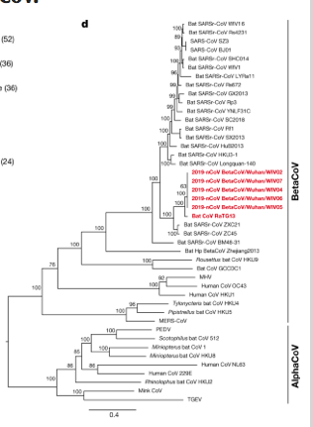
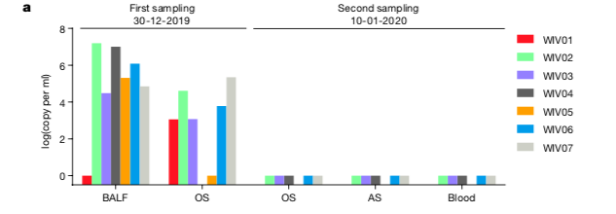
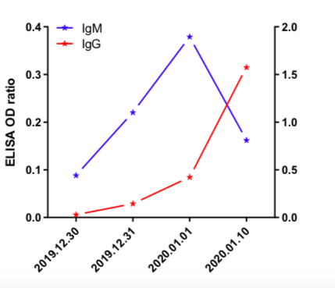
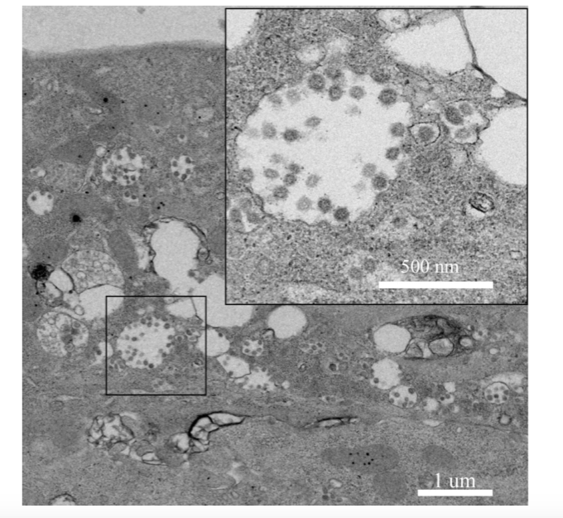
Het eerste bewijs
Zhou et al. 2020 https://www.nature.com/articles/s41586-020-2012-7?rel=outbound; shared online in preprint Jan 23d

Slide 5
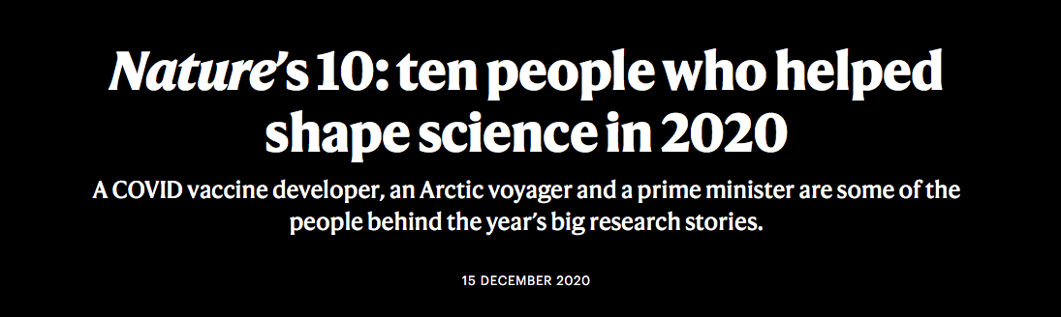
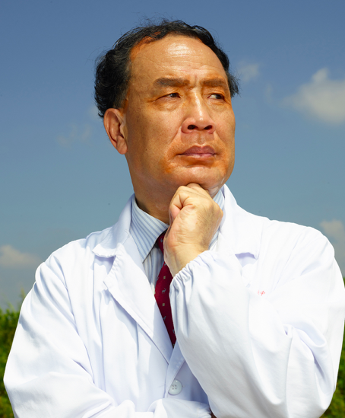
Prof Zhang Yongzhen
January 11th, 2020

Slide 6
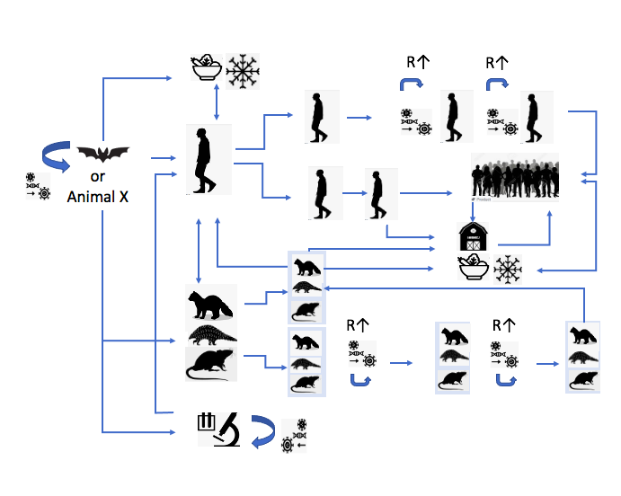
Most likely
Zoonotic via bridge host
Direct zoonotic
Foodborne introduction
Lab origin
Least likely
https://www.who.int/publications/i/item/who-convened-global-study-of-origins-of-sars-cov-2-china-part

Slide 7
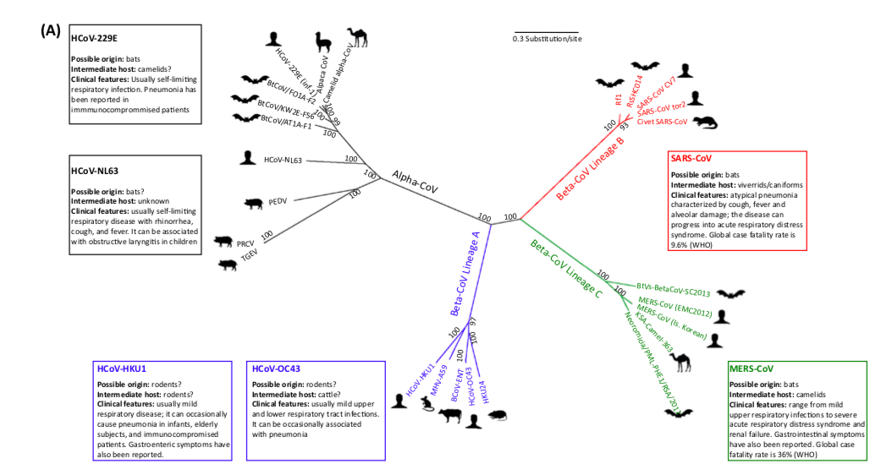
Forni et al. 2017 https://www.cell.com/action/showPdf?pii=S0966-842X%2816%2930133-0

Slide 8
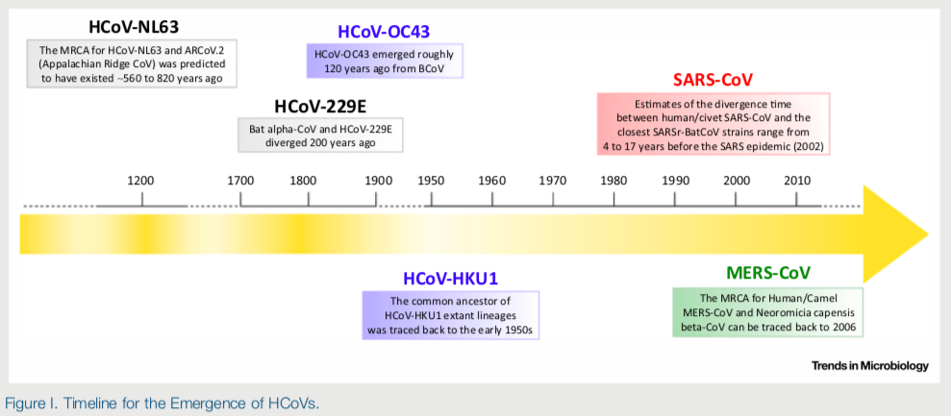
SARS-CoV-2
Forni et al. 2017 https://www.cell.com/action/showPdf?pii=S0966-842X%2816%2930133-0

Slide 9
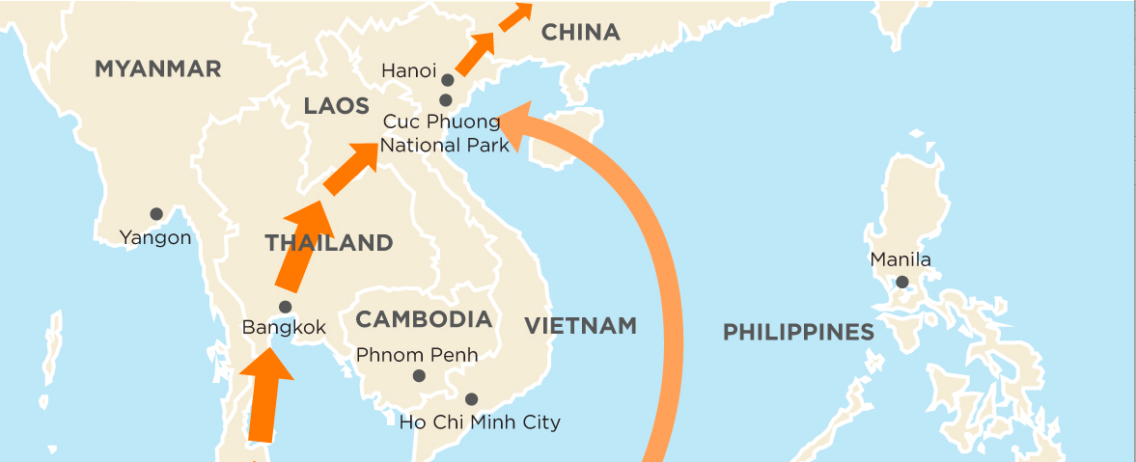
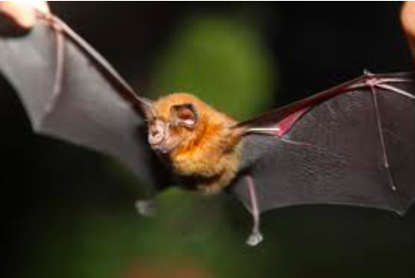
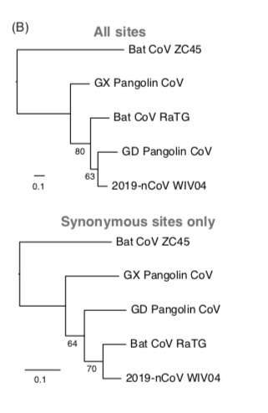
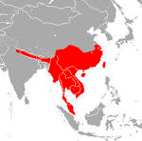
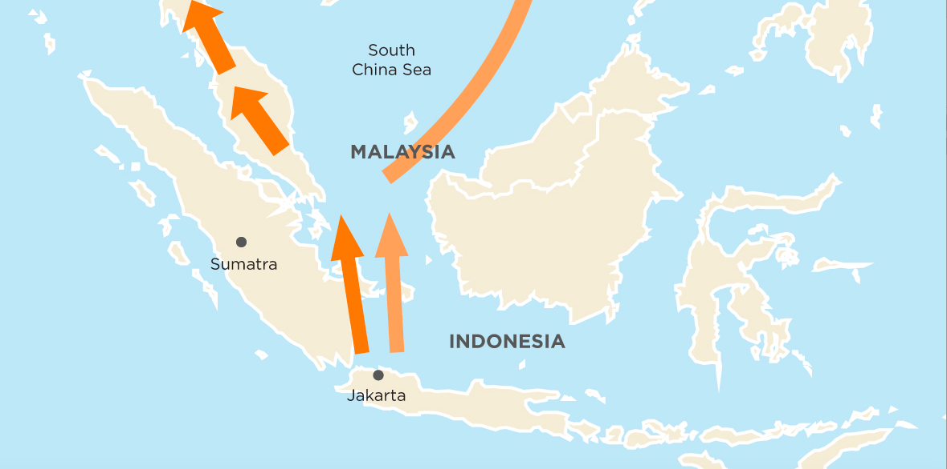
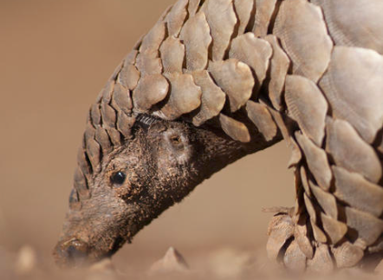
Rhinolophus affinis
Manis pentadactyla
Scales for traditional medicine (lactation)
Food ($350 per piece, Vietnam restaurant)
Critically endangered species
Tommy Tsan Yuk Lam et al, https://www.biorxiv.org/content/10.1101/2020.02.13.945485v1.full.pdf
https://edition.cnn.com/interactive/2014/04/opinion/sutter-change-the-list-pangolin-trafficking/

Slide 10
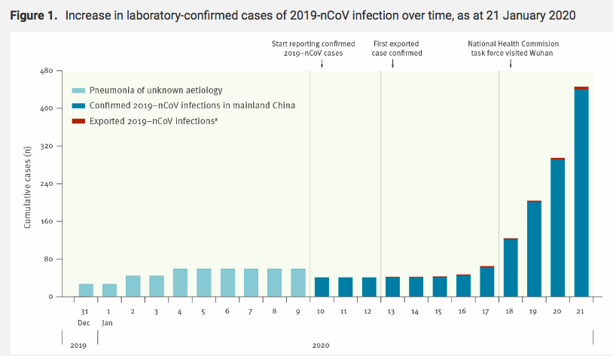
Cause declared
Distribution of PCR kits, China CDC
Confirmed
Cases

Slide 11
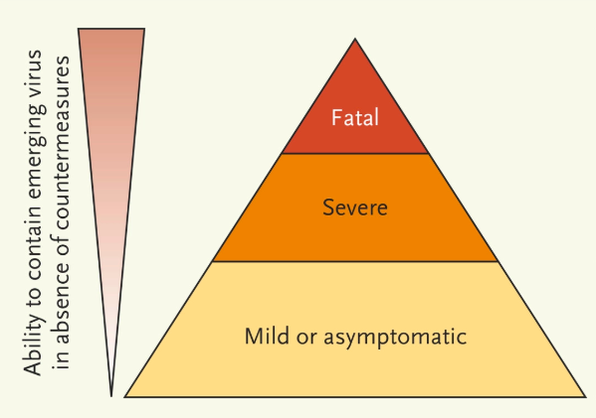
Ernst en omvang van de uitbraak vaststellen: een lastige vraag
Diagnostiek ontbreekt
Klachten zijn niet specifiek
Personen met milde klachten zijn niet in beeld
Serologische studies nodig
Onderzoek kost tijd
Combinatie van uitbraak onderzoek en bestrijding kan conflicteren
Munster et al., 2020

Slide 12
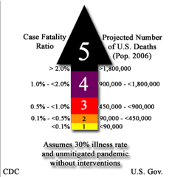
Pandemics are very different: introducing the pandemic severity index
5. Spanish flu, H5N1? H7N9?
4.
3.
2. Asian flu, Hongkong flu
1. Seasonal flu, Mexican flu

Slide 13
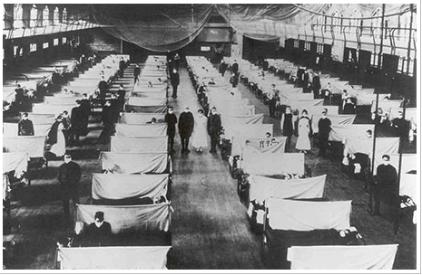
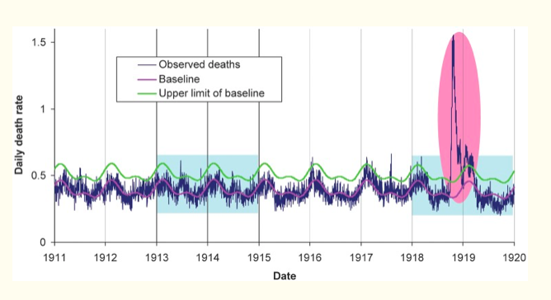
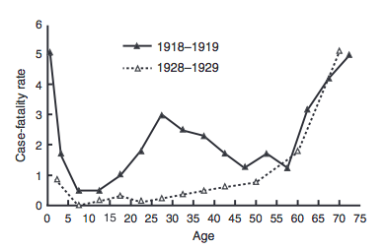
Spaanse griep, 1918, 1-2% CFR, maar andere leeftijdsverdeling
Viboud et al https://www.ncbi.nlm.nih.gov/pmc/articles/PMC3563305/
Wever en van Berger, 2014

Slide 14
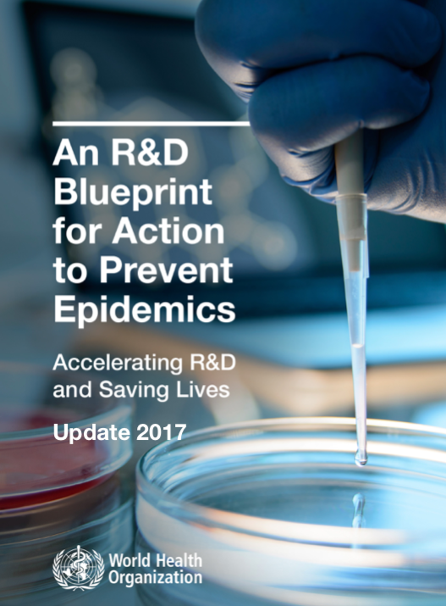


Key successes
The fast discovery of the etiology using
advanced technologies
The immediate sharing of essential data globally
Fast track development of diagnostics, vaccines
Fast track clinical trials
Global foresight > blueprint and CEPI
EU consortia in EID research
  PREPARE / RECOVER
  COMPARE / VEO
  EVD lab net
  ZAPI
  …..

Slide 15
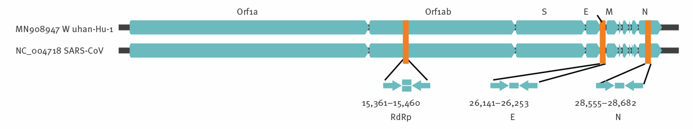



Figure
Sequence provided virological.org: Jan 12th
Primers shipped Rotterdam, London, HongKong Jan 13th
Validation from biobanked resp samples and from SARS RNA
Protocol shared on WHO site Jan 17th, published 20th
https://www.who.int/emergencies/diseases/novel-coronavirus-2019/technical-guidance/laboratory-guidance
Corman et al. 2020

Slide 16
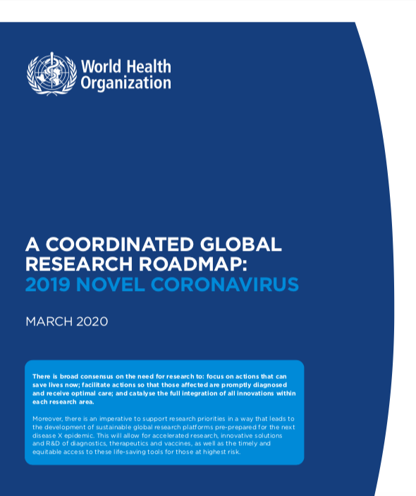
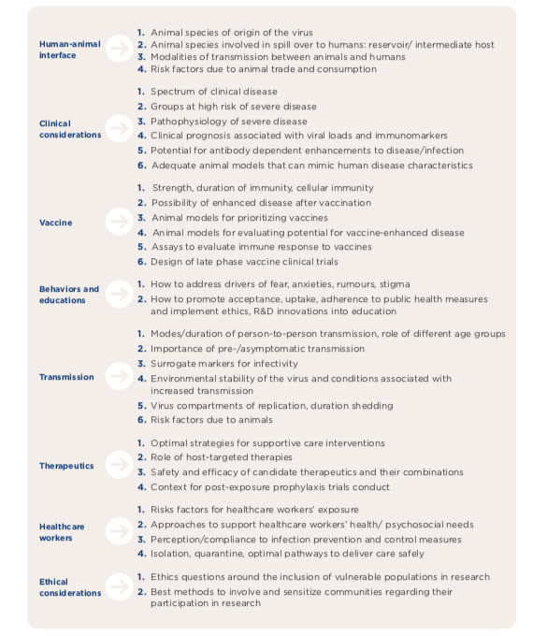
First research meeting Feb 11-12 2020

Slide 17


Slide 18
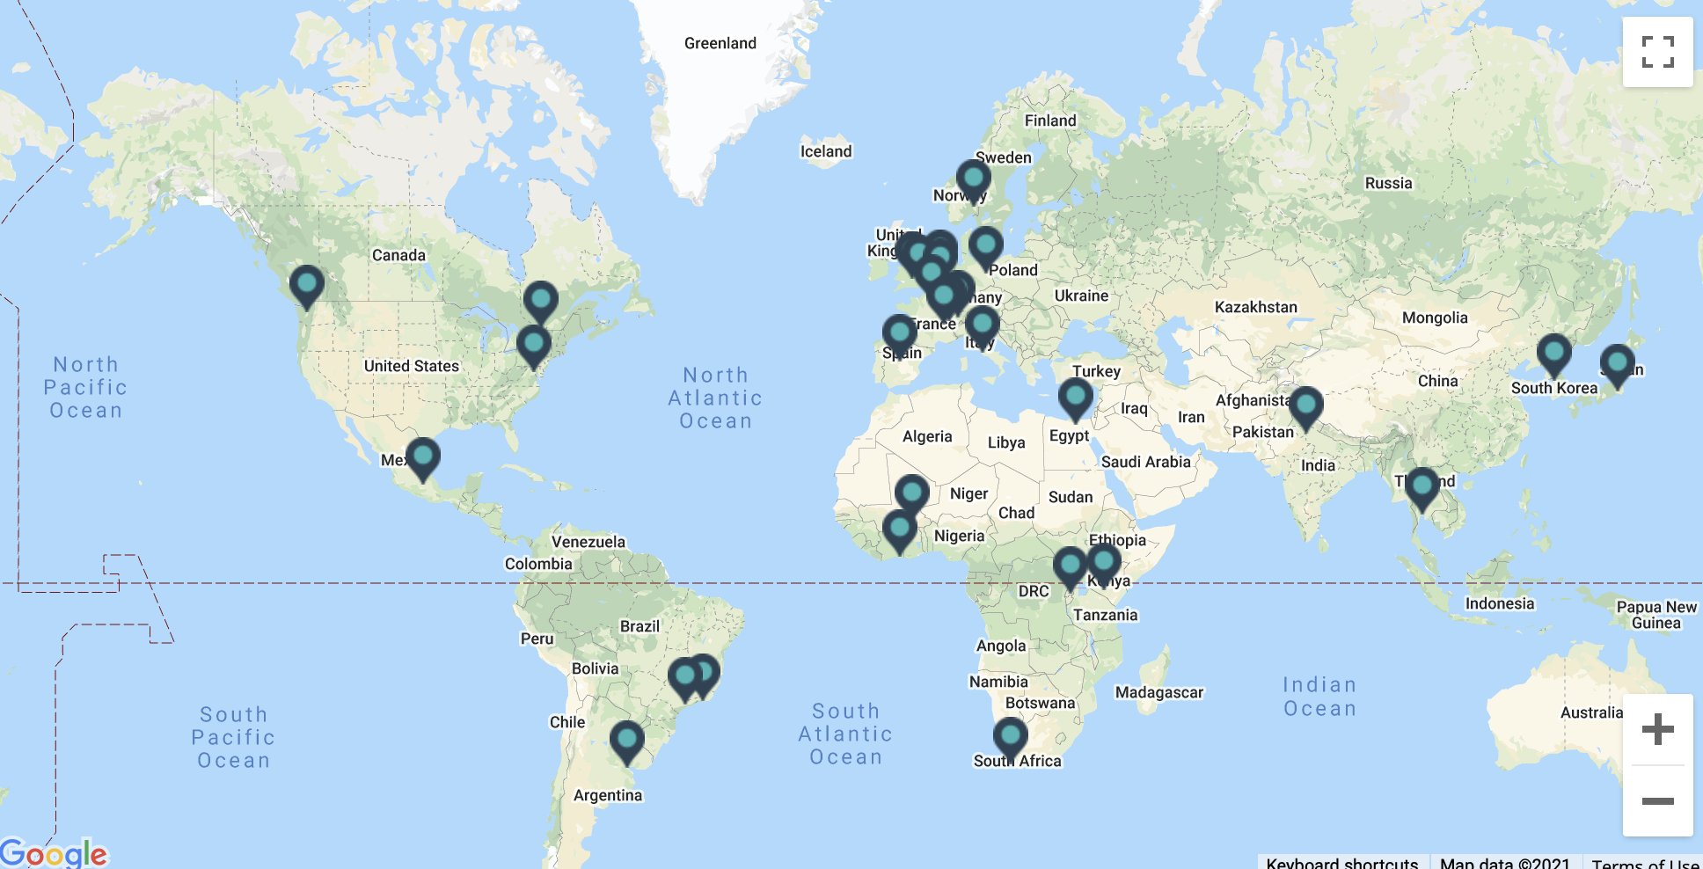

Slide 19
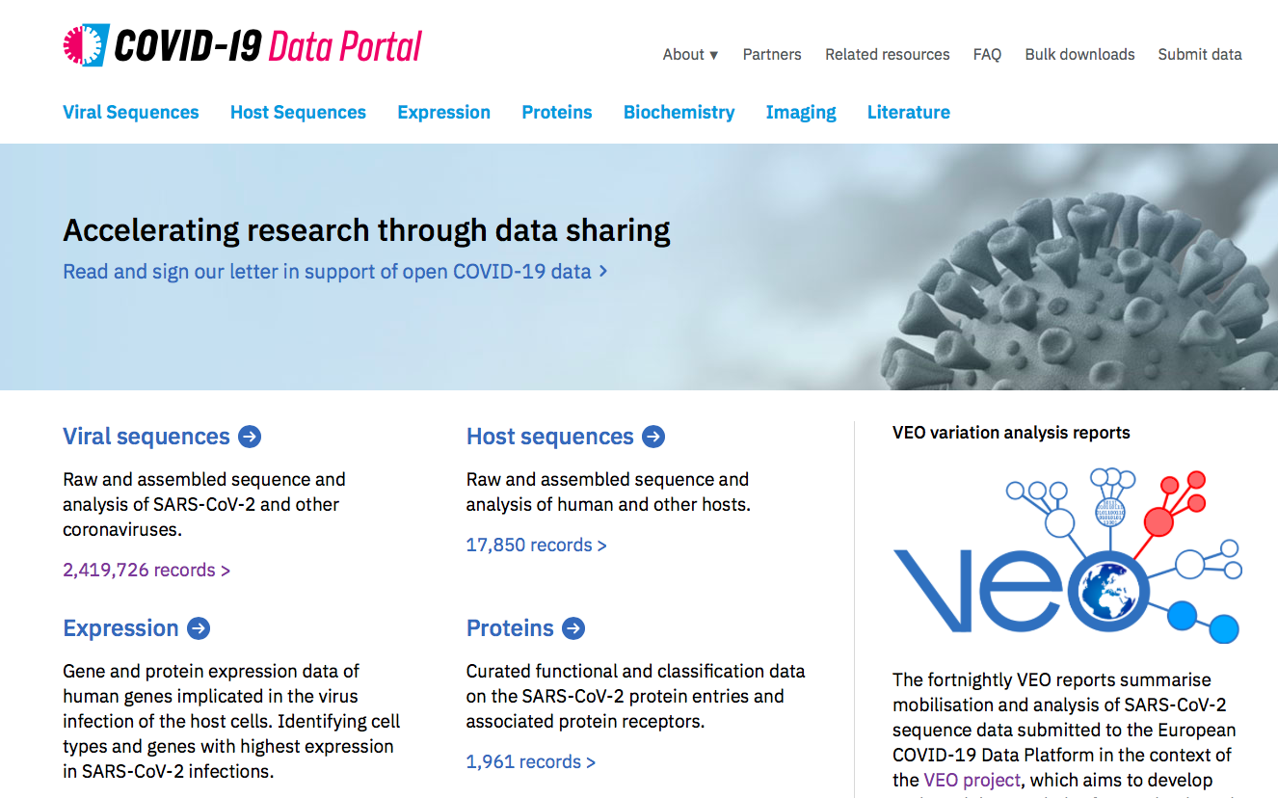

Slide 20
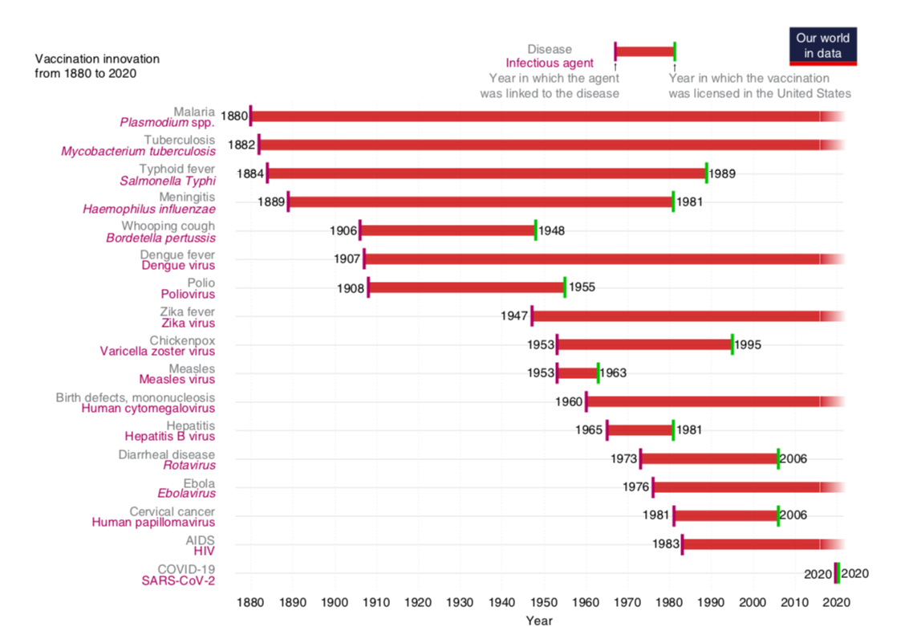



Slide 21
Key challenges
Fragmented and reactive public health response and research response (> 10.000 research projects funded)
Nationalism in pandemic research and response
  The pre existing networks were used only to a limited degree, but replaced by national networks
Market failure, shortages (lab tests, ICU equipment)
Administrative, Legal barriers. GPDR means different things in different countries in the Union
Infodemic
Politicized discussions
Threats

Slide 22
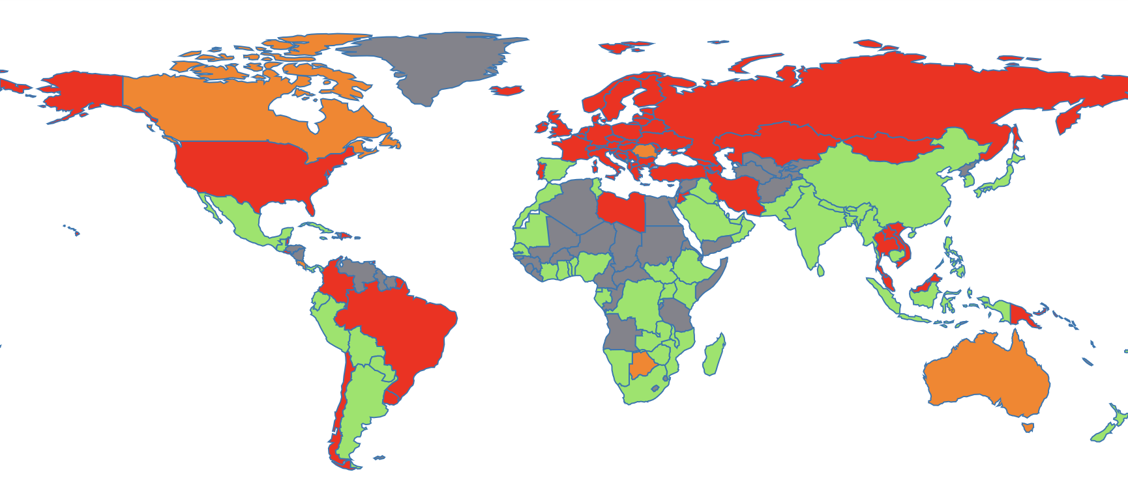
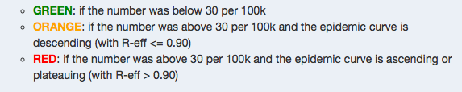
Data science challenges
Global risk map, 1-11-2021
https://renkulab.shinyapps.io/COVID-19-Epidemic-Forecasting/_w_6f83dd3c/_w_b5ffc5b2/_w_cc1cf94d/?tab=world_map

Slide 23
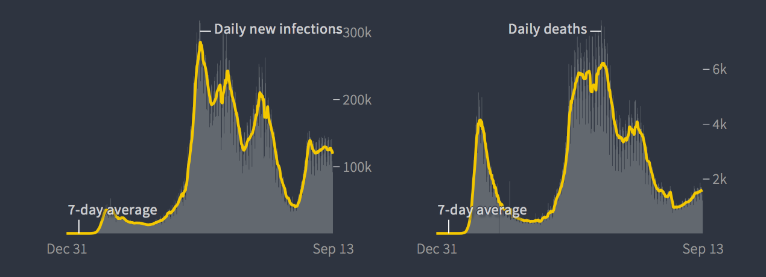
A challenge: the changing “meaning” of registered cases (example for European region)
Increased testing
Decoupling of case counts and hospitalisations/deaths
Bias for severe illness
https://graphics.reuters.com/world-coronavirus-tracker-and-maps/regions/europe/

Slide 24
Contributors to long term pandemic control
High levels neutralising antibodies blocking infection
Vaccine efficacy
  Duration of protection
  Vaccine immunity in risk groups for vaccination
Vaccination coverage
Distribution of vacination coverage
Demographics
Basic measures (staying home and testing when sick, hygiene)
Human behavior

Slide 25
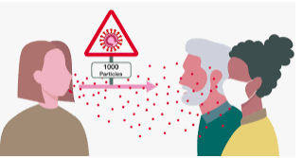
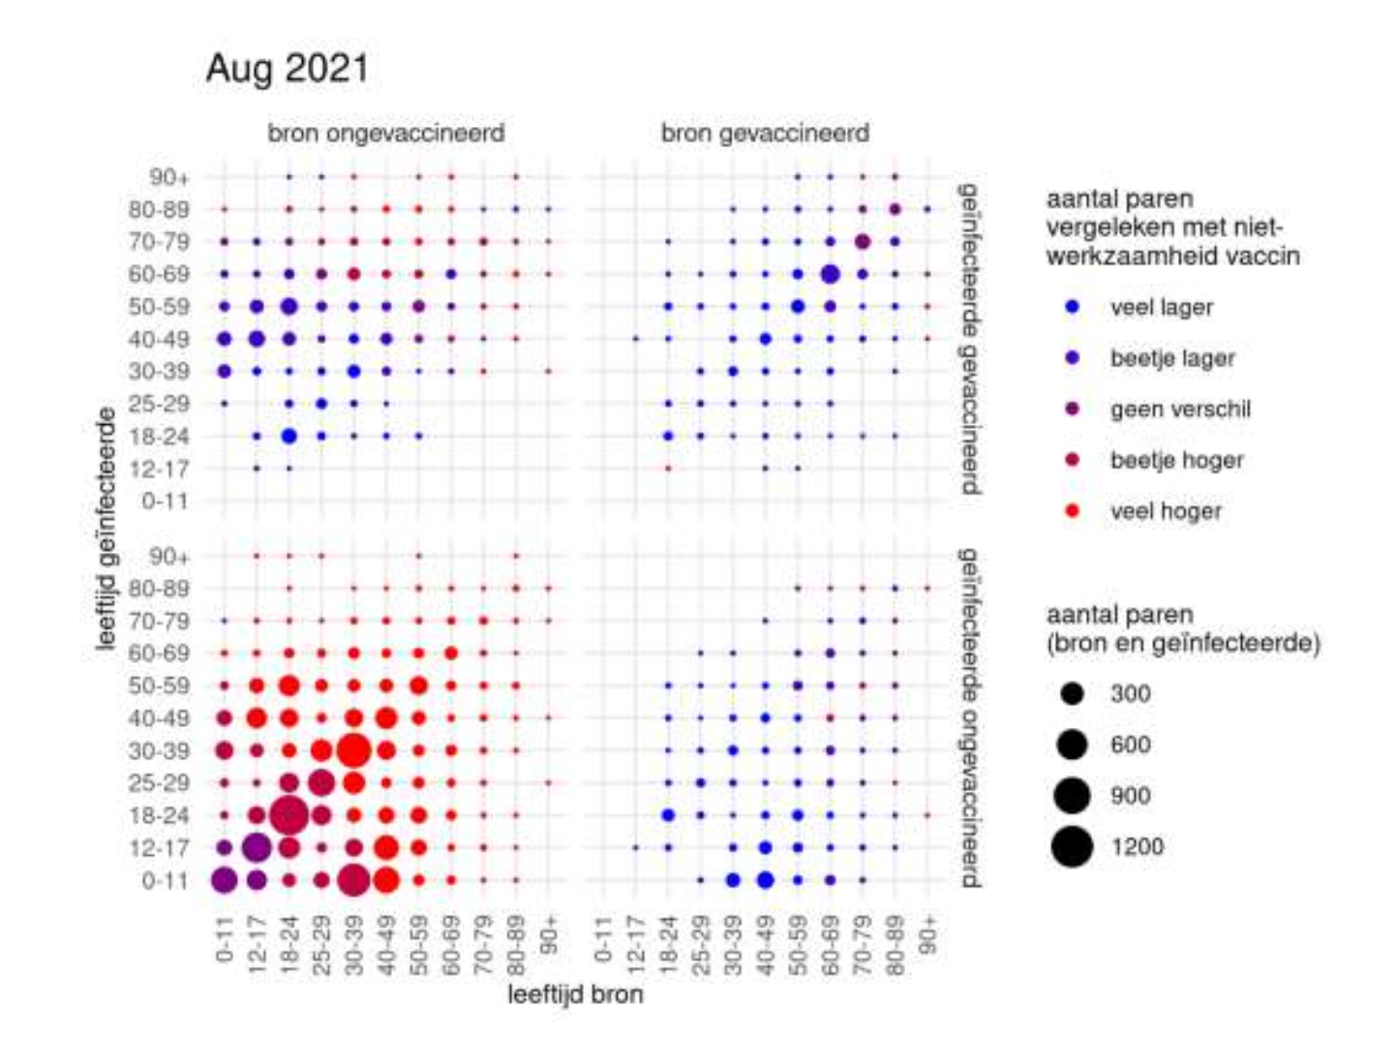
Infector
Infectee
Both non-vaccinated:
More cases than expected
Van Dissel, Kamerbriefing, Sept 2021

Slide 26
Infector
Infectee
Both vaccinated
Less transmission than expected
Van Dissel, Kamerbriefing, Sept 2021

Slide 27
Infector
Infectee
Infectee
vaccinated
Less transmission than expected
Van Dissel, Kamerbriefing, Sept 2021

Slide 28
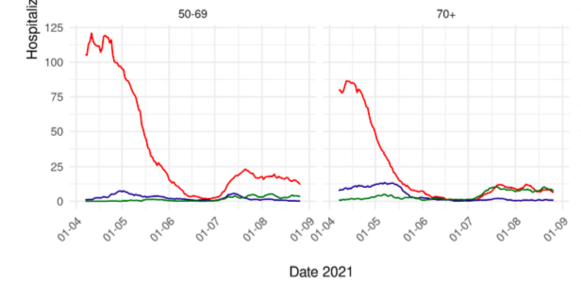
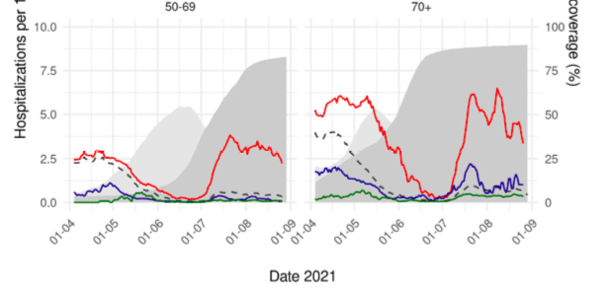
Number hospitalized
vaccinated/non vaccinated
Incidence hospitalized
vaccinated/non vaccinated
Much higher in non-vaccinated
Similar in
Both groups
De Gier et al. https://www.medrxiv.org/content/10.1101/2021.09.15.21263613v1

Slide 29
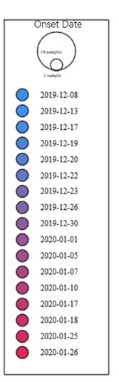
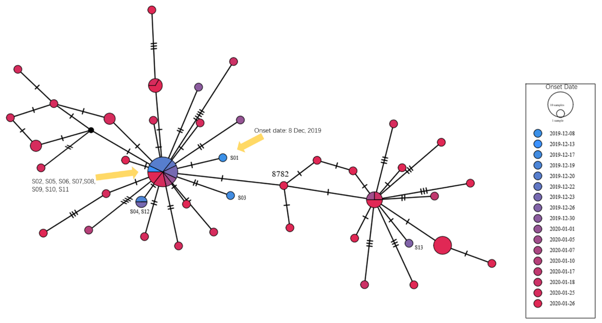
Virus from the first identified cases already differ > missed circulation? Repeated spillovers?
tMRCA mid november – early december
https://www.who.int/publications/i/item/who-convened-global-study-of-origins-of-sars-cov-2-china-part

Slide 30
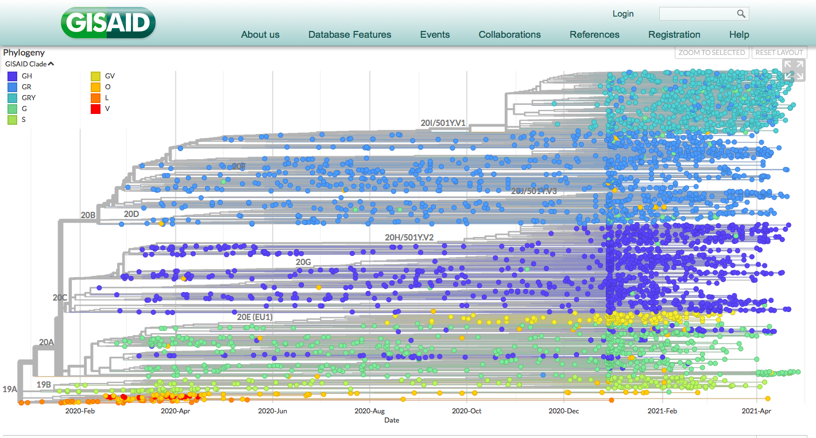

Slide 31
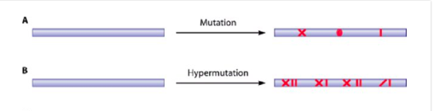
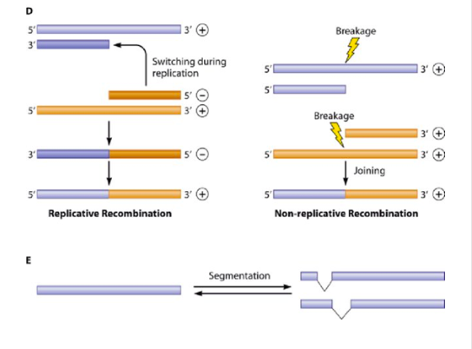
Main types of genetic variation in viral genomes
Esteban Domingo et al: Quasispecies Dynamics Taught by Natural and Experimental Evolution of Foot-and-mouth Disease Virus
from: Foot-and-Mouth Disease Virus: Current Research and Emerging Trends. Caister Academic Press, U.K. (2017) Pages: 147-170.
Notes:
Figure 7.2 Scheme of main types of genetic variation in viral genomes. (A) Mutation due to miscopying of template residues by viral replication complexes. (B) Hypermutation (high frequency of biased mutation types) often due to cellular editing activities. (C) Genome segment reassortment. (D) Homologous, replicative (left), and non-replicative (right) recombination. (E) Genome segmentation as documented with FMDV (described in Domingo et al. (2012), with permission from the American Society for Microbiology, Washington DC, USA.

Slide 32
Consequences of genomic diversification
Most mutations have no impact on function or structure of virus
Some can be harmful for virus survival, some can result in advantage
    Diagnostic sensitivity decrease
    Increased transmissibility
    Escape from (vaccine)immunity
    Treatment escape
Some can result in other effects
    Increased disease severity, virulence
    Changes in host range

Slide 33
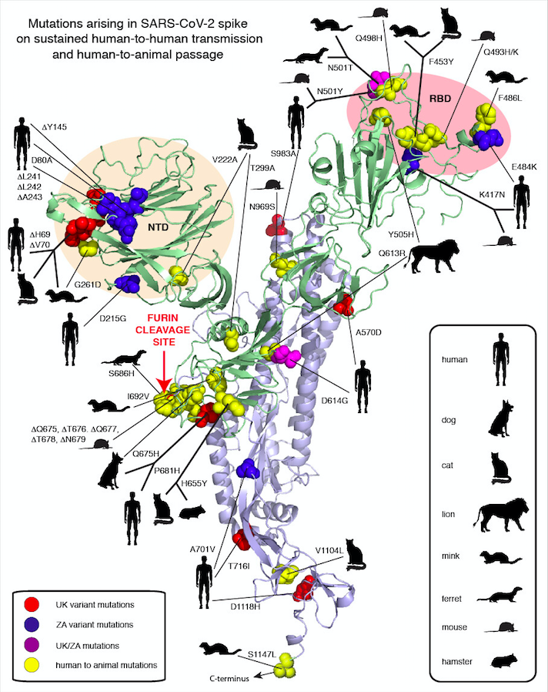
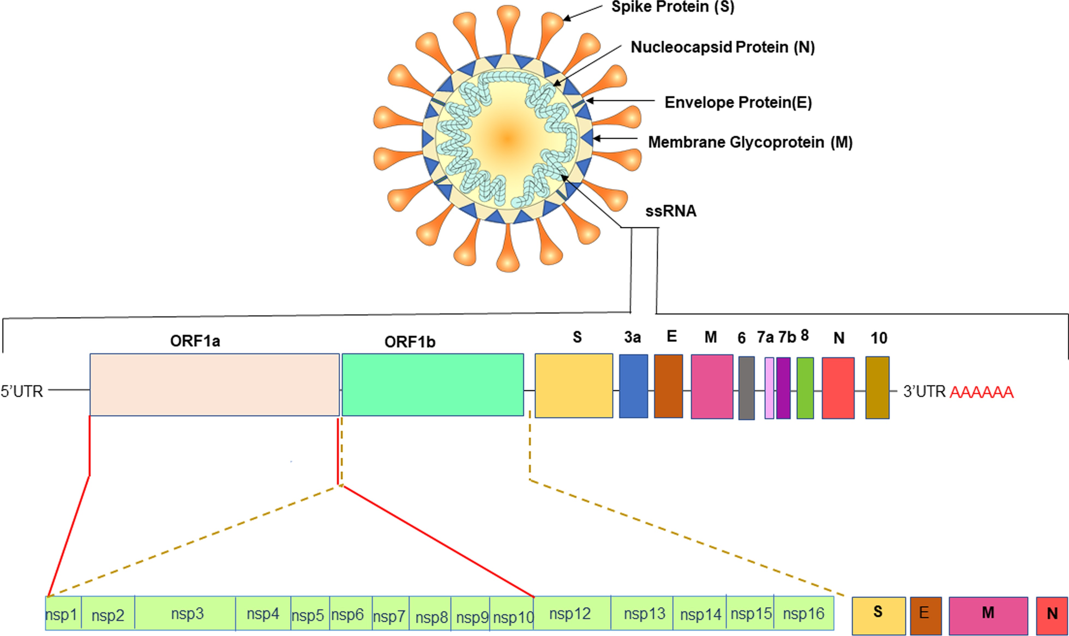
RBD mutations > better/different binding, immune escape?
NTD mutations / deletions > immune escape?
Mutations furin cleavage site > host range adaptation, tropism?
Mutaties aa 613/614 > replication efficiency?
Garry, https://virological.org/t/mutations-arising-in-sars-cov-2-spike-on-sustained-human-to-human-transmission-and-human-to-animal-passage/578

Slide 34
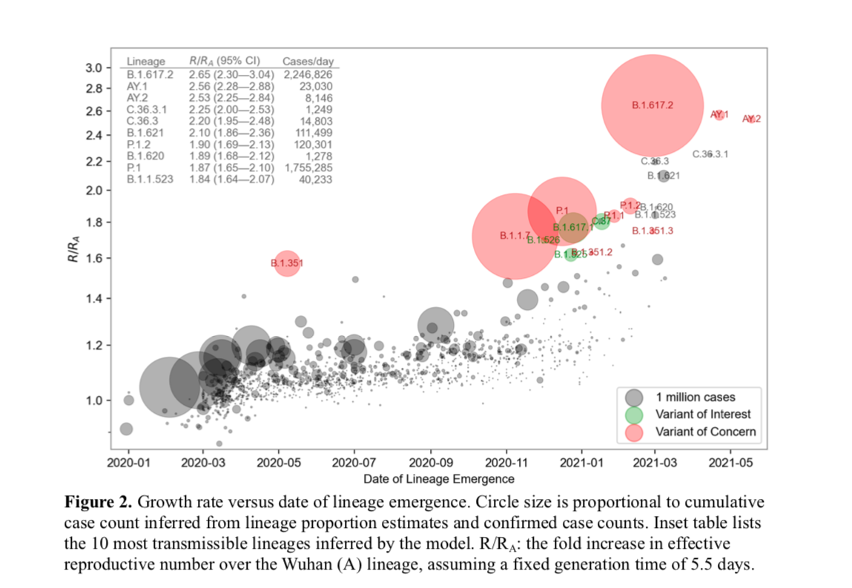
Delta
Gamma
Mu
Alpha
Beta
Obermeyer et al https://www.medrxiv.org/content/10.1101/2021.09.07.21263228v1.full.pdf

Slide 35
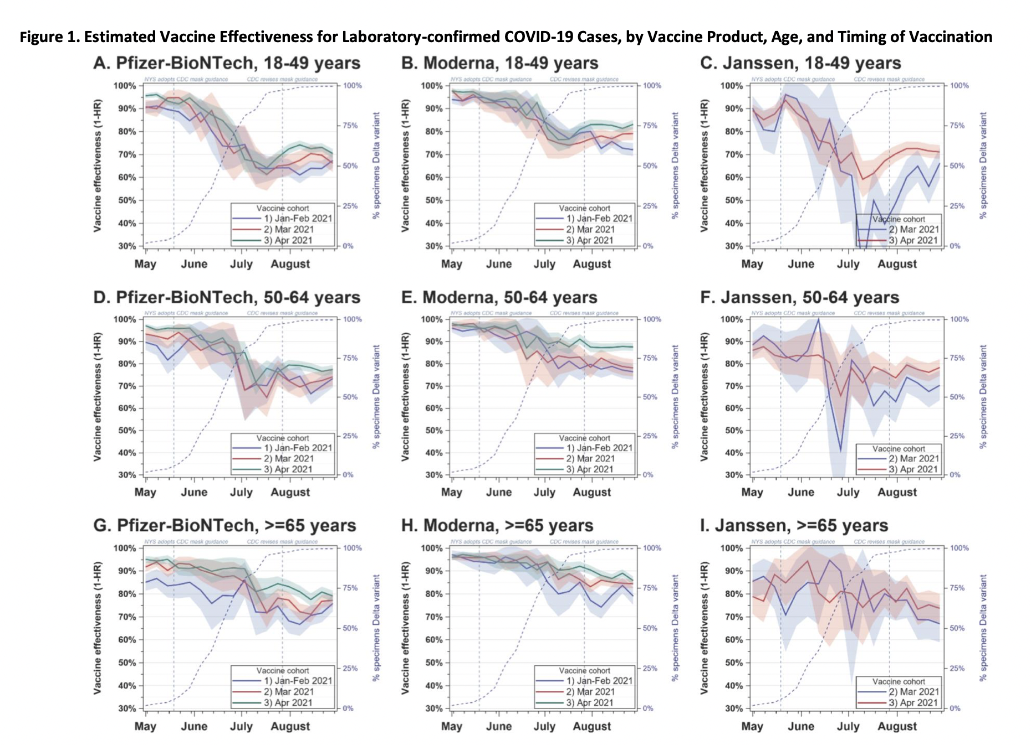
Rosenberg et al https://www.medrxiv.org/content/10.1101/2021.10.08.21264595v1.full.pdf

Slide 36


Slide 37


Based on Mathieu et al. Nature human behaviour. 2021 https://doi.org/10.1038/s41562-021-01122-8

Slide 38


Modellering RIVM, Wallinga, 29-10-2021
opnames
IC

Slide 39

Vergelijking 2020
Geschat maximum
Huidig niveau

Slide 40
Wat “doet” influenza komend seizoen: een complexe vraag
Hoe verloopt de COVID-19 pandemie en zijn er nog beperkende maatregelen?
Wat is het effect van uitblijven van influenza op de omvang van de seizoenspiek?
Hoe is de match met de vaccins?

Slide 41

Uitblijven van de piek en immuniteit
Volwassenen
Model obv serologie > geleidelijke toename van deel bevolking dat gevoelig is voor influenza
Voor kinderen: extra groot cohort primo infecties
H1
H3
Kinderen
Ranjeva et al. 2019 https://www.ncbi.nlm.nih.gov/pmc/articles/PMC6458119/pdf/41467_2019_Article_9652.pdf

Slide 42

Vervroegen van de seizoenspiek?
Antistoffen tegen seizoens coronavirussen in jonge kinderen April 2020 en April 2021
Nazomer golf van RSV onder jonge kinderen en volwassenen
Jonge kinderen minder vaak blootgesteld aan respiratoire virussen (Sikkema et al)
Grotere groep gevoelige kinderen > grotere influenza piek bij kinderen
Sikkema et al, submitted for publication

Slide 43

Wat is de te verwachten omvang?
Infection attack rates influenza in unvaccinated individuals
22%
Children
11%
Adults
Somes et al; Vaccine 2018 https://pubmed.ncbi.nlm.nih.gov/29716771/

Slide 44

Overlap in risicoprofiel COVID-19 en influenza > effect op impact influenza bij ouderen?
Omgekeerd effect bij toenemende andere luchtweginfecties (interferentie)?
Dimiter Toshkov, Leiden University, based on CBS; http://dimiter.eu/Visualizations_files/nlmortality/Excess-Mortality-in-the-Netherlands.html

Slide 45

Influenza surveillance en vaccin stam selectie
Nauwelijks virus circulatie in 2020
Weinig drift?
Vaccin stam

Slide 46



Noord Europa
ziekenhuis
huisarts
Zuid Europa
Sporadische gevallen in NL
Weinig testen via huisartsen > meld systeem mogelijk minder betrouwbaar

Slide 47


Mike Ryan
WHO health emergencies program
June 7, 2019
https://apps.who.int/iris/bitstream/handle/10665/325126/SITREP_EVD_DRC_20190602-eng.pdf?ua=1

Slide 48




Global spread of African swine fever. Sanchez-Vizcaino et al., 2014
2007
2012
2019
Steep increase in porc meat prizes Xia et al, 2021
Driver for SARS COV 2 emergence?

Slide 49
> 1990: the 4th epidemiological transition, new diseases resulting from human behavior and impact on the planet
CHANGE in demographics of humans and animals
CHANGE in political landscape
CHANGE in behavior
CHANGE in pathogen behavior
CHANGE in technology
CHANGE in climate
…..
Increased risk of
(new) diseases, including infectious diseases
Omran, 1971; Martens 2002 ; World Economic Forum report, 2015; Jones et al, 2008

Slide 50


Current approach: investigation of disease ecology mostly after spillover to humans/livestock
Karesh et al., 2012

Slide 51


EID preparedness research
Can we:
Predict Risk?
Develop capacity to detect all relevant pathogens / infections?
Detect outbreaks early?
Prevent?
Anthropocentric
Ecocentric / One Health

Slide 52

Vragen bij een virale spillover
Wat is de oorzaak?
Waar komt het vandaan?
Hoe ver is het verspreid?
Hoe ernstig is de ziekte?
Is het besmettelijk?
Zijn mensen (deels) beschermd?
Hoe is het te stoppen?
Wolfe et al., 2007; Gytis et al., 2017

Slide 53
Spillovers: Can we predict which viruses can jump species?
H5N6, H7N9, Nipah,
MERS, Monkeypox….
What is out there?
What are drivers?
Wolfe et al., 2007

Slide 54





Virus discovery
“1.2 billion to detect all viruses on earth”
Virus discovery
Mora et al., 2011;
Geoghegan and Holmes, 2017

Slide 55

Explosive spread: Can we predict risk of (urban) amplification? Ebola, MERS CoV, Lassa, Nipah, ….
What are drivers?
Can early detection be targeted?
What is potential utility of catch-all detection methods?
how to predict phenotype from genotype
Wolfe et al., 2007; Gytis et al., 2017

Slide 56

Can we predict cycle transitions?
Zika, dengue, chikungunya, yellow fever…
Langerak T, Mumtaz N, et al. 2019;

Slide 57

Changing suitability of North-West Europe for arboviruses
2016: massive outbreak of Usutu
15% reduction of blackbird population
Twee clades, one of them 3 years in a row (established)
Infected blood donors
Rijks et al., 2016; Cadar et al., 2017
Oude Munnink et al., 2019

Slide 58



New tools for surveillance: metagenomcs
using DNA / RNA as common language
Combined with hotspot prediction and eco-system sampling
https://www.compare-europe.eu; Hendriksen et al., 2019; Phan et al., 2019; Oude Munnink et al., 2019

Slide 59



Zwarts et al. (2009)
Zwarts nL., Bijlsma R.G., van der Kamp J. & Wymenga E. 2009. Living on the edge: Wetlands and birds in a changing Sahel. KNNV Publishing, Zeist, The Netherlands

Slide 60
Pandemic preparedness
Is much broader than currently has been done
Is urgent, as new challenges will arise
Needs to be multidisciplinary and system oriented
Requires novel models for governance, data infrastructures, decision making
Needs an international focus
Needs public funding as a basis
Needs engagement swith private sector for specific aspects

Slide 61











Acknowledgements
ErasmusMC
Bart Haagmans
Nisreen Okba
Mart Lamers
Anna Mykytyn
Tim Breugem
Mathijs Raadsen
Debby Schipper
Reina Sikkema
Zsofia Igloi
Erwin de Bruin
Pieter Fraaij
Brenda Westerhuis
Gijs van Nierop
Bas Oude Munnink
Barry Rockx
Ron Fouchier
Sander Herfst
Dennis de Meulder
Theo Bestebroer
Felicity Chandler
Anne van der Linden
Richard Molenkamp
Jolanda Voermans
Annemiek Vandereijk
Jeroen van Kampen
Corine Geurts van Kessel
RIVM
Jaap van Dissel
Chantal Reusken
Adam Meijer
Aura Timen
Bas van der Veer
Lisa Wijsman
Sharn van den Brink
Gabriel Goderski
Johan Reimerink
UU
Berend Jan Bosch
Chunyan Wang
Wentao Li
UA, Antwerpen
Herman Goossen
Greet Ieven
PREPARE consortium
AUMC
Menno de Jong
Oxford University
Pater Horby
James Lee
Lousie Sigfrid
INSERM, Parijs
Yazdan Yazdanbach
Diane Descamps
Quentin Le Hingrat
Nadhira Fidouh
Charite University Berlin
Christian Drosten
Victor Corman
WHO GLAP HP, Geneva
Mark Perkins
Karin von Eije
Maria van Kerkhove
Peter Benembarek
GGD medewerkers
Laboratorium medewerkers
Patienten en hun contacten

